Slide 1
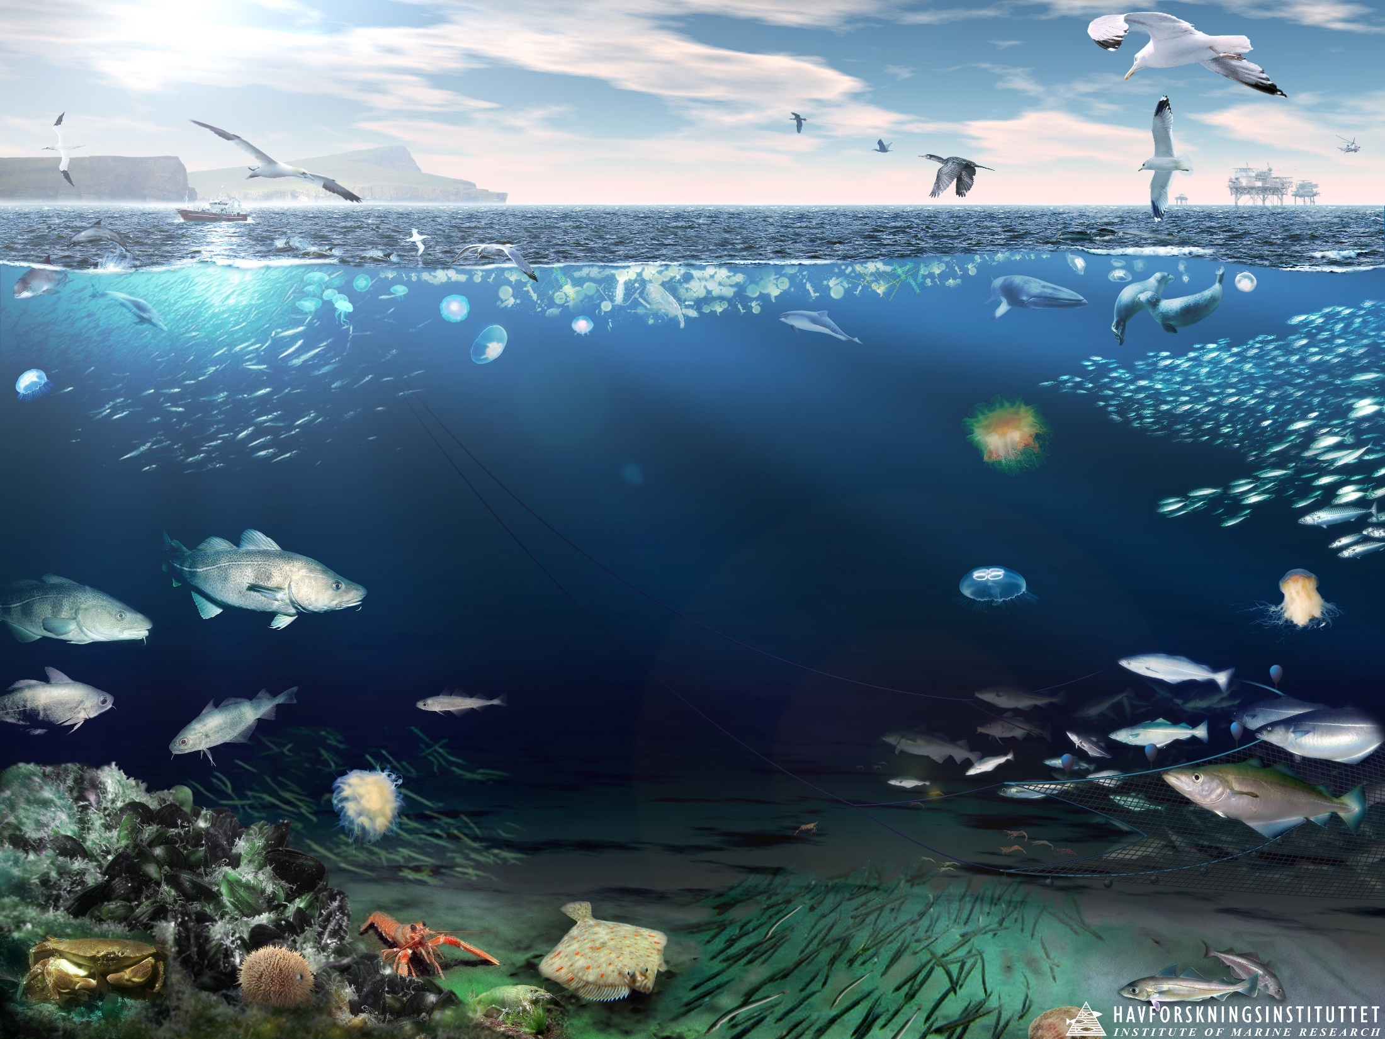
Marine Ecosystems and Social Needs The importance of merging social and natural science for servicing policy needs to the best for humans and nature
Gro I. van der Meeren, IMR, Bergen, Norway
Based on the presentations:
GI van der Meeren et al 2017, at Arctic Council conference in ecosystem-based Asessment Fairbanks, US August 2017 and
GI van der Meeren 2017, at Ocean sustainability under global change, workshop in Bergen, Norway 1. September 2016

Slide 2
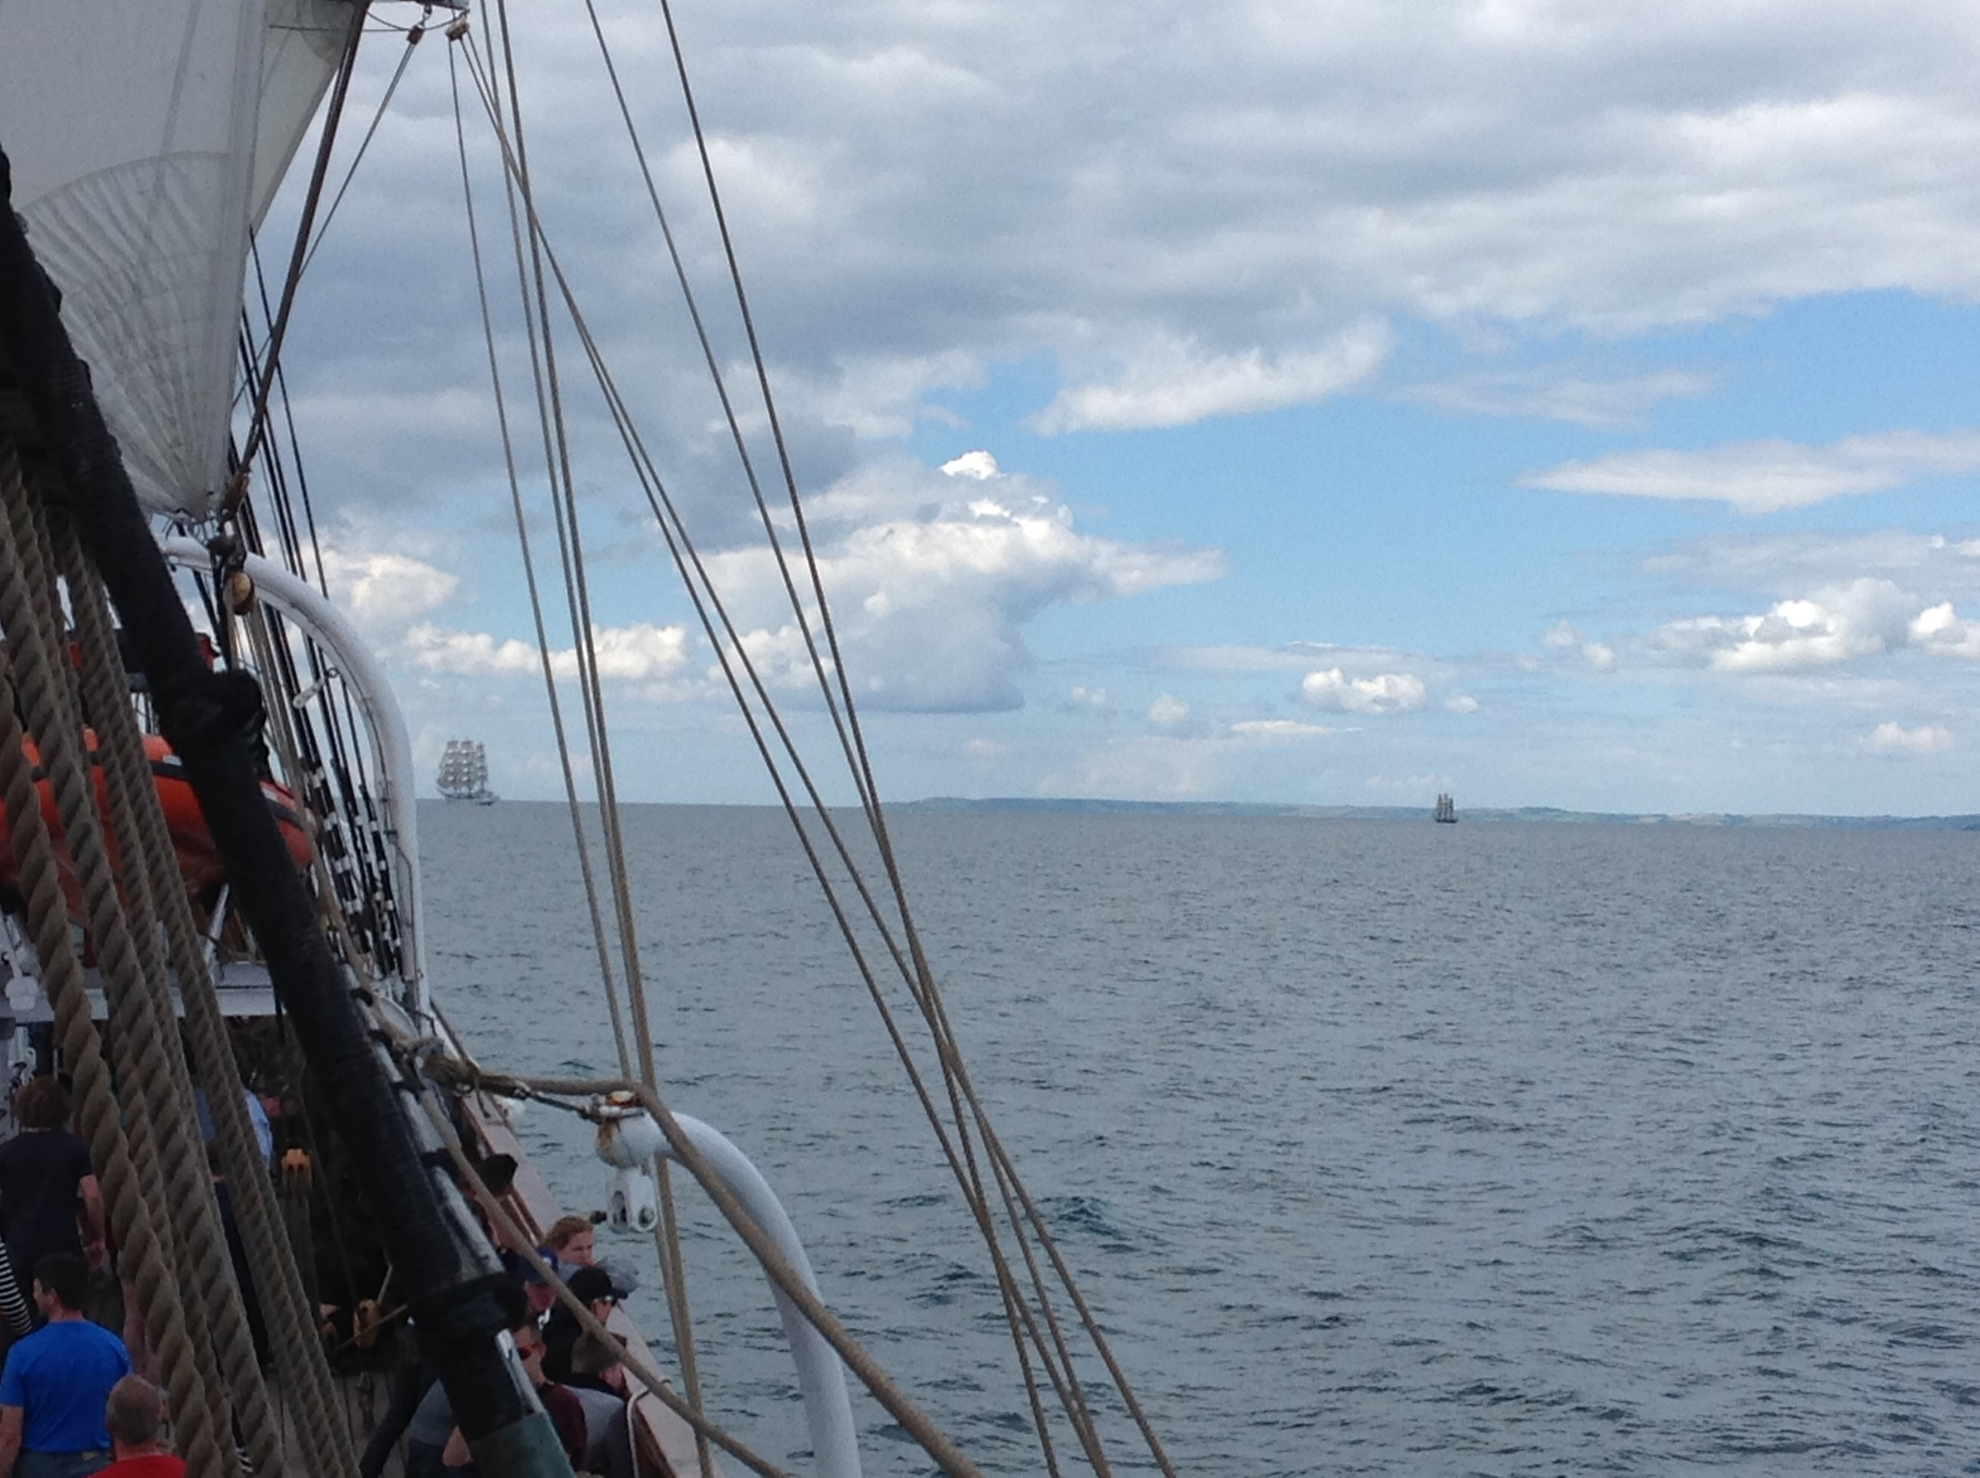
Content
Marine ecosystems and the need for managing them
Value of ecosystems and ecosystem components
Drivers inlfuencing management decisions
Norwegian aims for socio-ecological research on marine policy

Slide 3
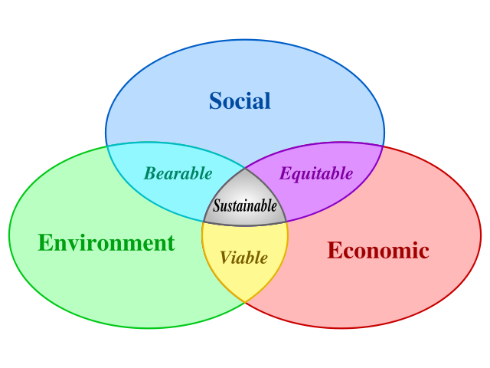
Marine ecosystem-based management EBM
Considers the entire ecosystem, including humans
The goal:
Maintain an ecosystem in
a healthy, productive, and resilient condition
Secure long-term supply of ecosystem services
Compass 2005 /
Dr. Mark Zacharias

Slide 4
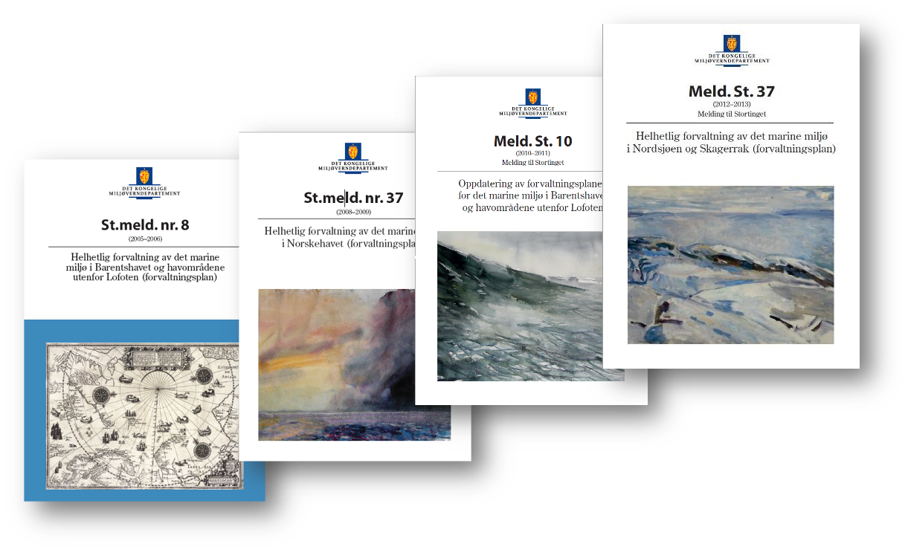
Assessing states and trends in large marine ecosystems of Norway

Slide 5
How are marine ecosystems assessed and managed?
Identify the ecosystem
Describe the ecosystem
Set ecological objectives
Assess the ecosystem
Value the ecosystem
Manage human activities
The system of knowledge
The regulatory process
From: Jason S. Link, Phil Mundy, NOAA-National Marine Fisheries Service
PAME conference Fairbanks August 2016
Ecosystem Approach to Management and Integrated Ecosystem Assessments

Slide 6
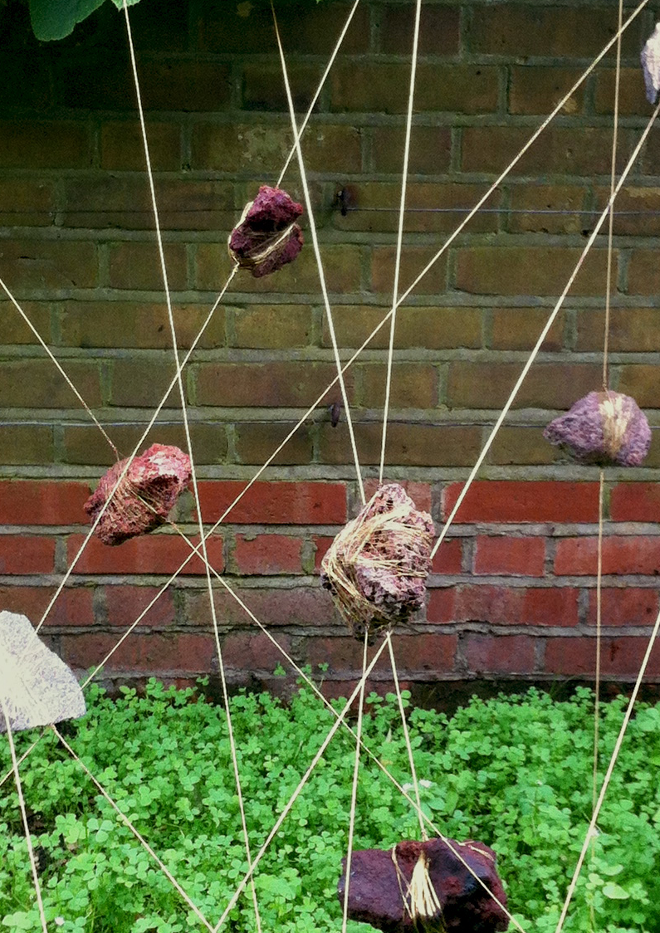
Golden Cage
James P. Graham

Slide 7
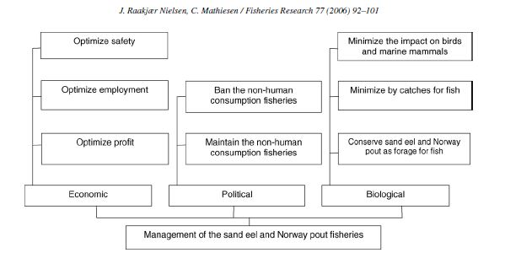
Need or greed?
Case: Management of the fisheries for non-human consumption species in the North Sea

Slide 8
Need or greed?
Case: Management of the fisheries for non-human consumption species in the North Sea
Cluster 1: Conservation-oriented perspective
Cluster 2: Balanced eco-fishery perspective
Cluster 3: Economic-oriented perspective
Jesper Raakjær Nielsen ∗, Christoph Mathiesen 2006. Stakeholder preferences for Danish fisheries management of sand eel and Norway pout. Fisheries Research 77 (2006) 92–101

Slide 9
Socio-ecological framework to unravel (marine) impacts of climate change on human communities
Climate change
Ecosystem structure
and Processes
Human well-being
Ecosystem Services
Regulating
Provisioning
Cultural
From: Marianne Falardeau, Audrey Rochon, Elena Bennett, Dept. of Natural Resource Scinces, McGill Univ., Quebec, Canada PAME conference Fairbanks August 2016: Ecosystem Approach to Management and Integrated Ecosystem Assessments
Notes:
Ecosystem services: 70 % of Arctic studies published by USA, Canada and Norway
Human Well-being: 80 % by Canada and USA (on inuit well-being)
Ecosystem services:
Regulating services: Mostly biological control, followed by a fraction on carbon sequestration
Provisioning services; Mainly seafood, followed by new species and selected species or group of species
Cultural services: Mainly traditional knowledge followed up by cutural identity and sense of place

Slide 10
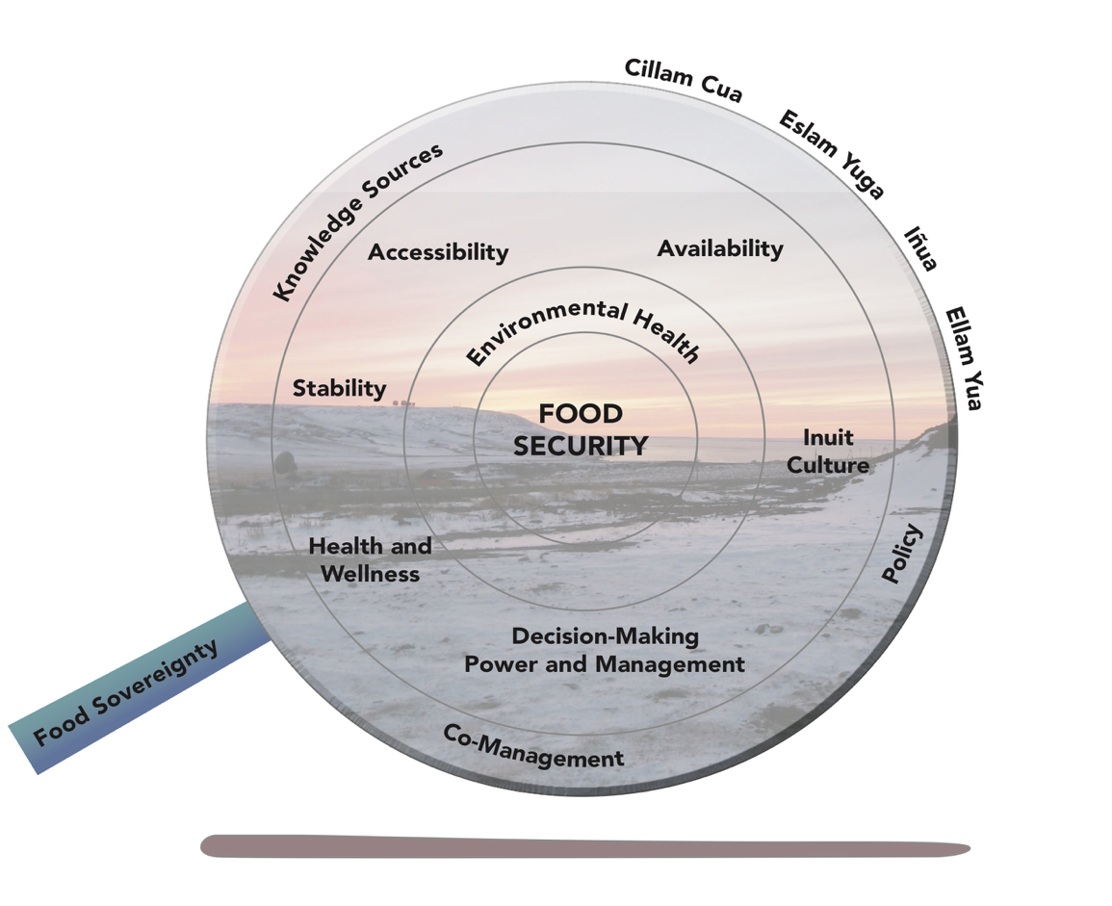
Inuit Food Security Conceptual Framework
From a presentation by Carcolina Behe 2016, at the PAME conference Ecosystem Approach to Management and Integrated Ecosystem Assessments, Fairbanks, Alaska,
August 2016

Slide 11
What research needs to be done?
Improving integrated ecosystem assessments
Assess and give guidance on how institutions should evolve in the next decade
More research is needed into the exploitation trade-offs
Create scenarios and visualizations
Improve how we deal with uncertainties

Slide 12
What research needs to be done?
Focus more on solutions-oriented science
Integrate research, where relevant
Work towards a common language and value-setting
Self-reflection needed

Slide 13
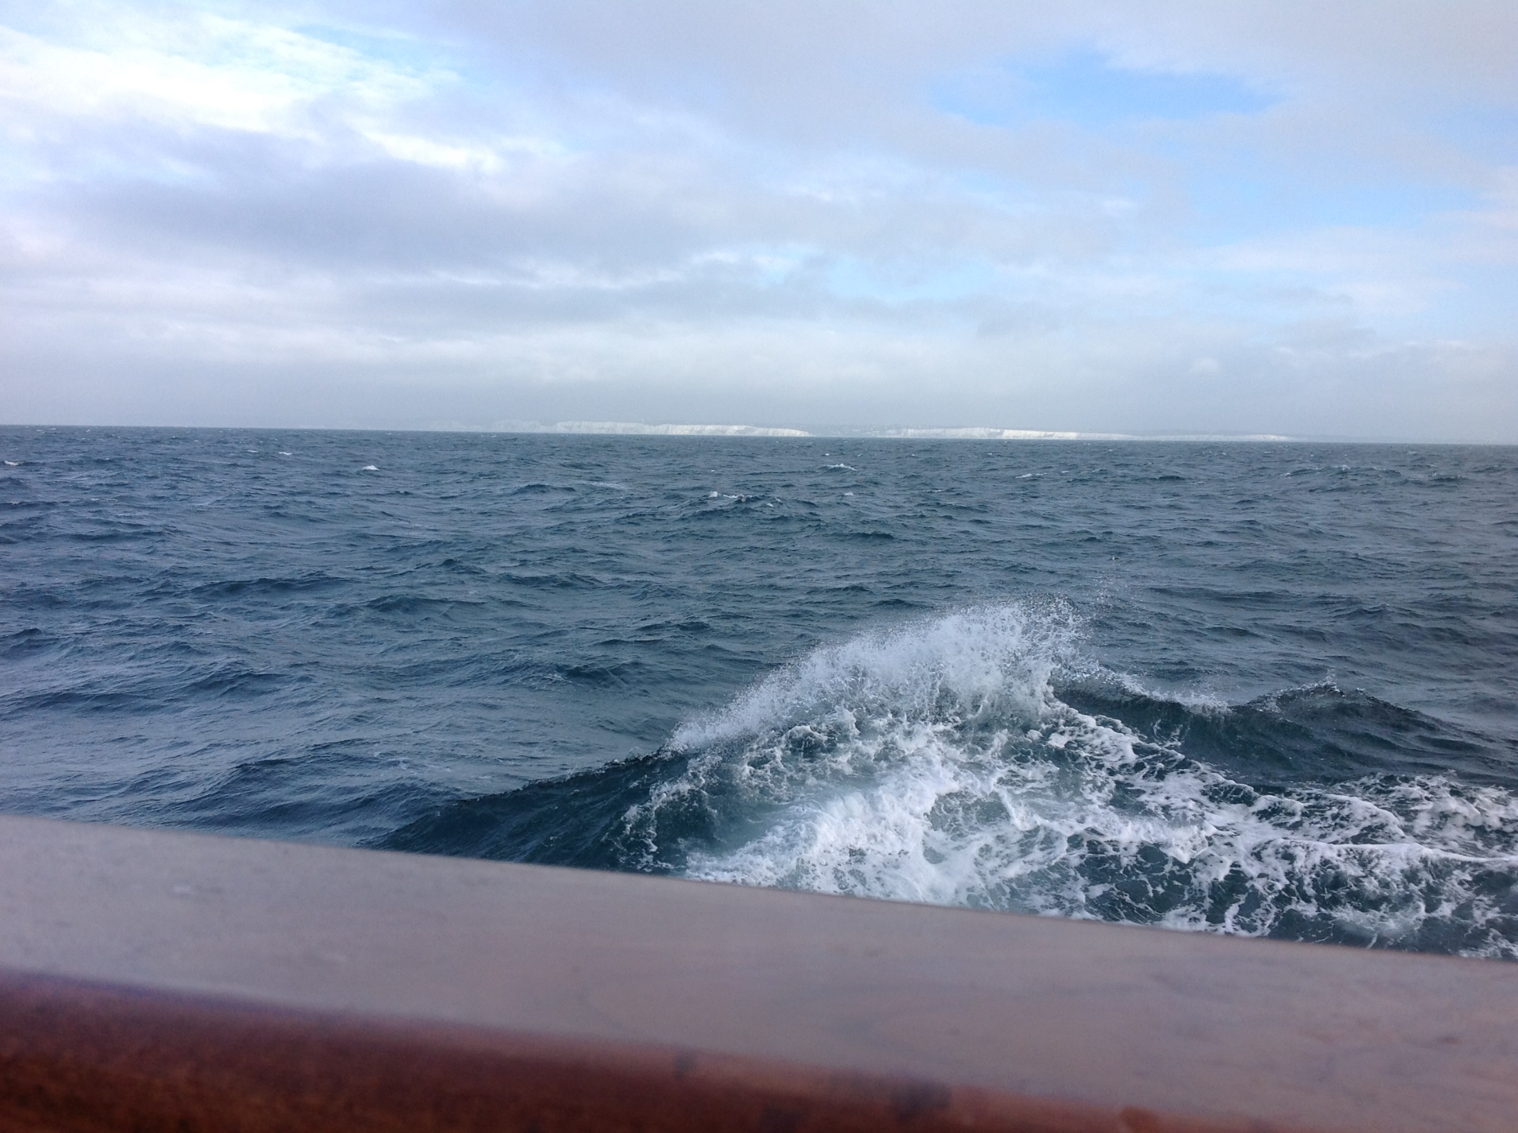
In short:
Reach out across academic cultures and language, to close the gap and understanding for the needed acceptance of humans dependency of healthy ecosystems, including the vast seas

Slide 14
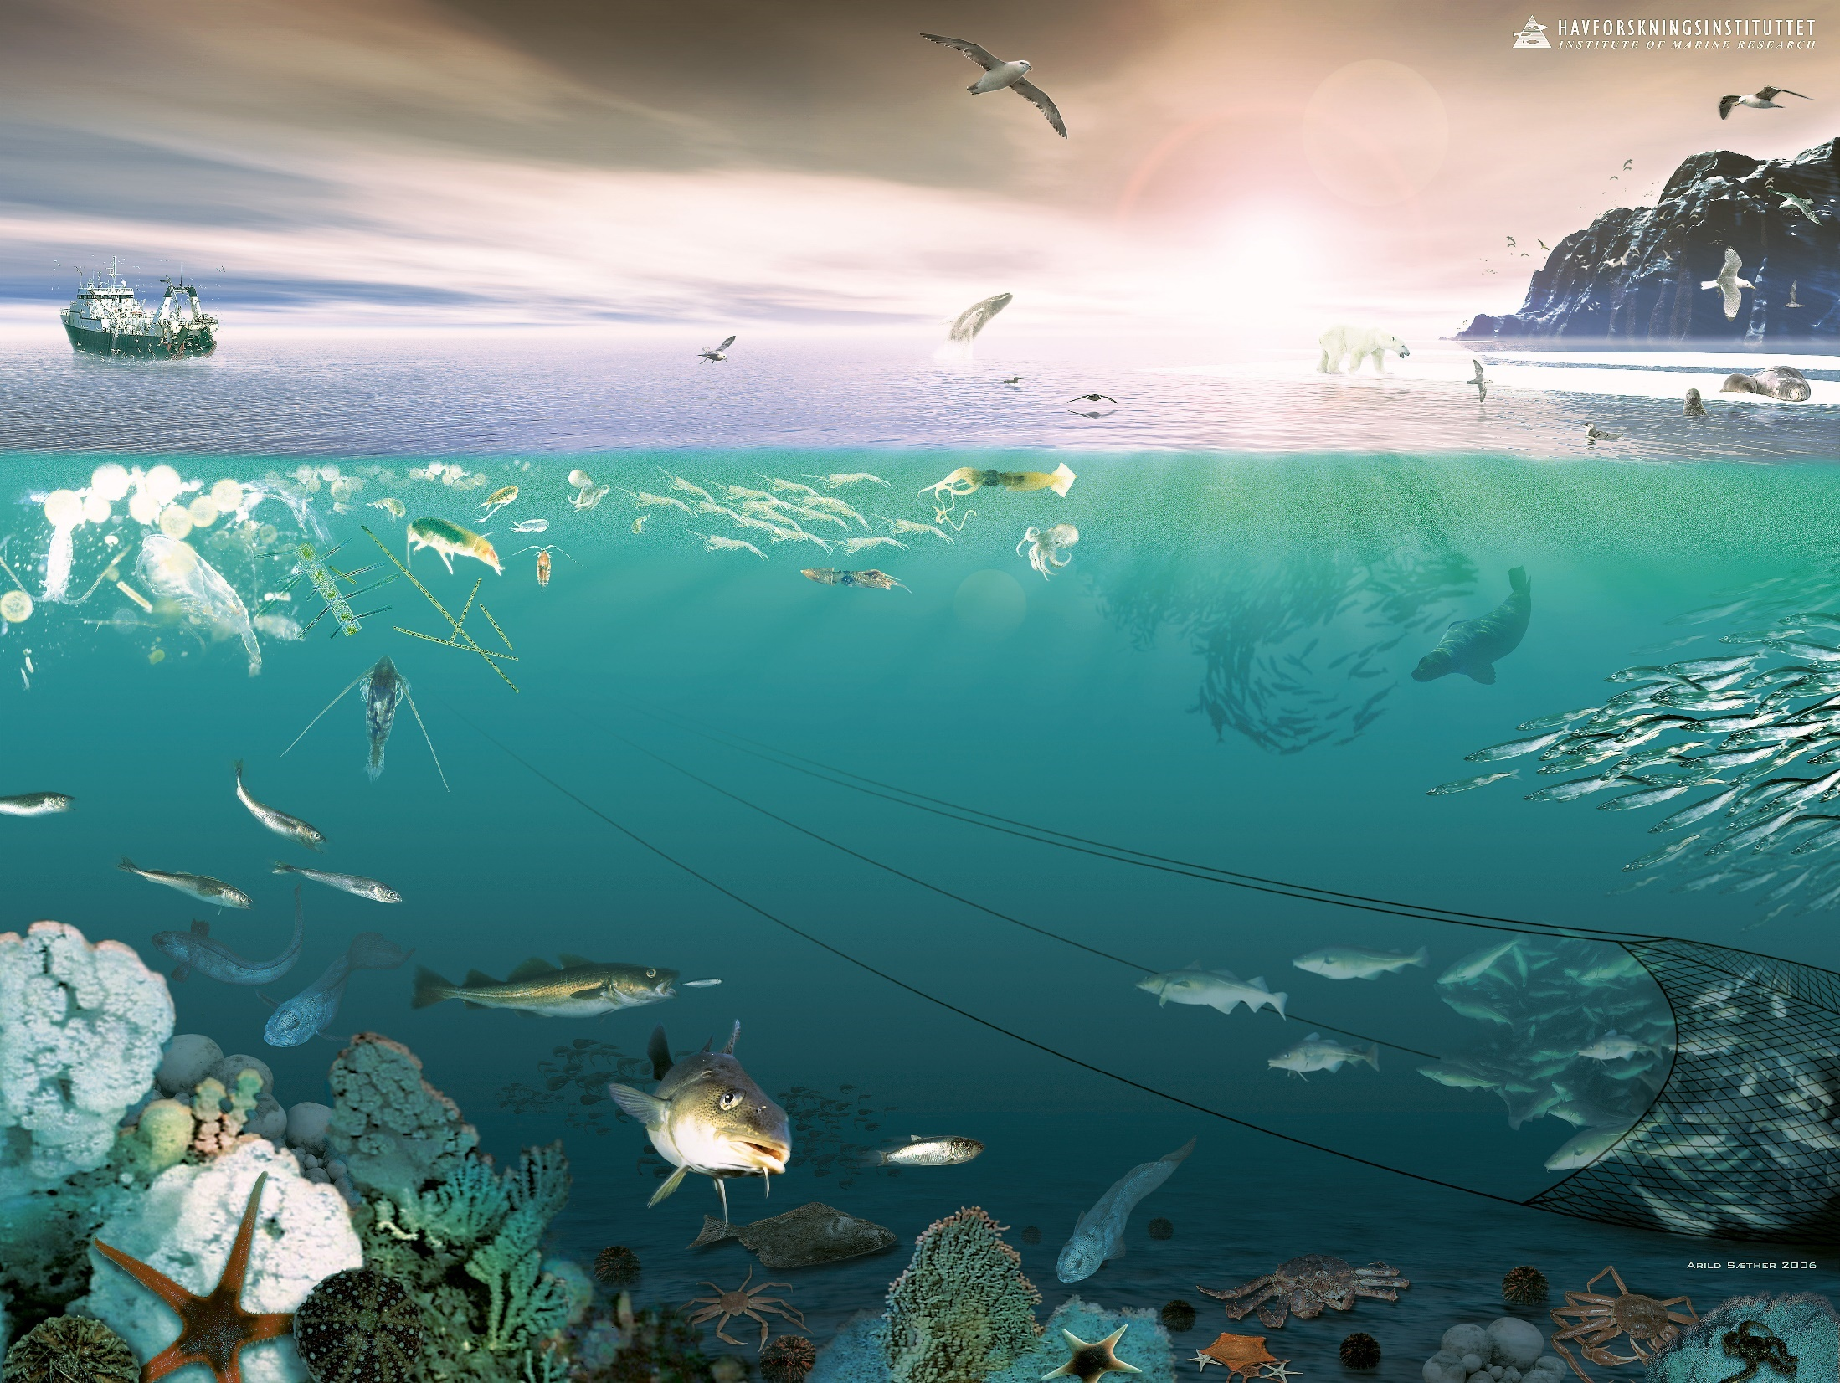
Thank you

