Slide 1

Deep Vision - non-extractive fish sampling for stock surveillance
Shale Rosen
Research Group Fish Capture /
CRISP Centre for Research-based Innovation
November 4, 2015
Boston, MA USA
Transatlantic Science Week 2015
Session 3.1 Productive Seas and Oceans: Fisheries
Notes:
Tittelside

Slide 2













CRISP Centre for Research-based Innovation in Sustainable fishing and Pre-processing technology
Industry
Research Institutes
Universities
.
.
Funding from industry partners and
.
.
.
Notes:
Nofima = Norwegian Institute of Food, Fisheries and Aquaculture Research
Univeristy of Tromsø =«The Arctic University of Norway»

Slide 3

Deep Vision
In-trawl stereo camera + analysis software
Goal: identify and measure all passing objects without taking them onboard

Slide 4
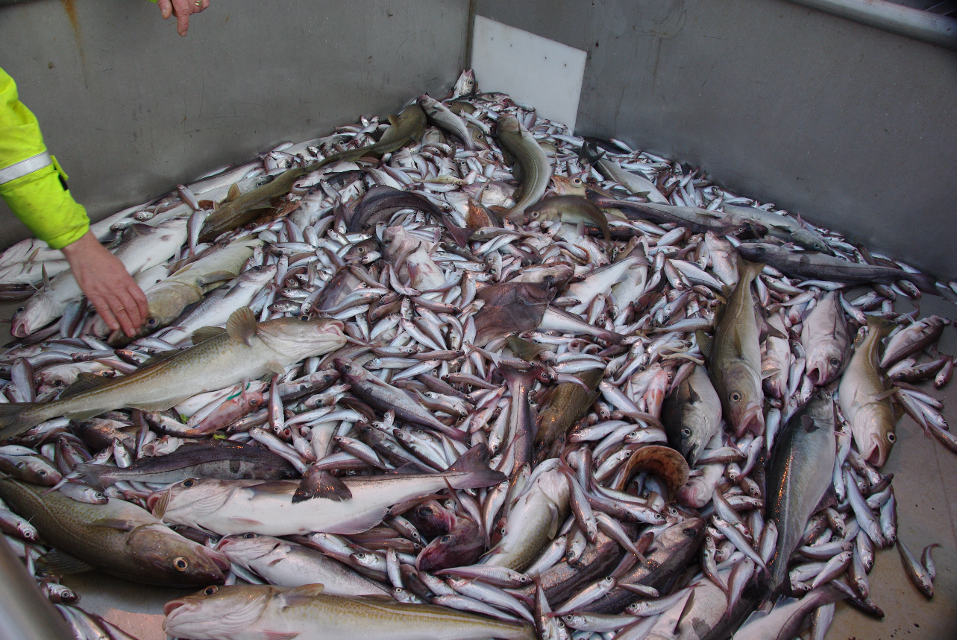

Trawl sampling today
All catch is accumulated and mixed in the trawl
Where were the different species captured?

Slide 5
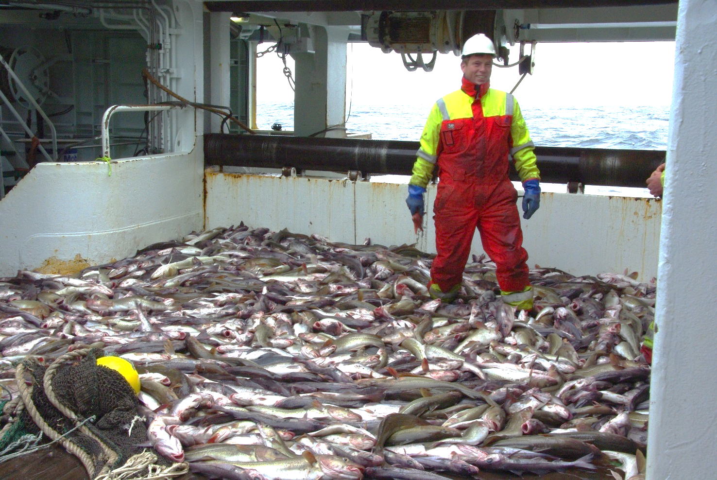
Trawl sampling today
Many fish are simply measured and thrown back overboard
(or never even measured)

Slide 6
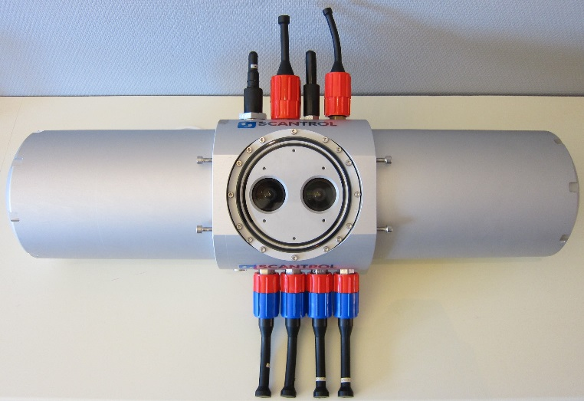
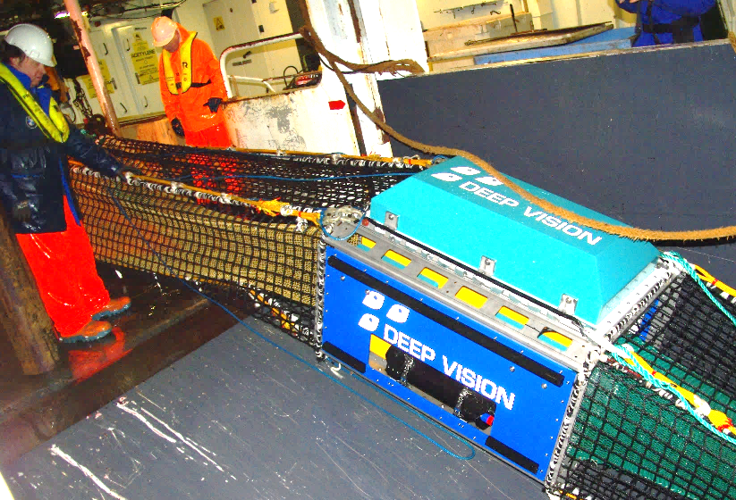
Deep Vision
In-trawl stereo camera + software
Cameras, PC for storage / control
Powerful LED lights (not pictured)
Battery powered for 8 hours
5 image pairs per second
Placed inside frame in trawl for protection / lighting / fish positioning

Slide 7
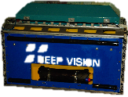
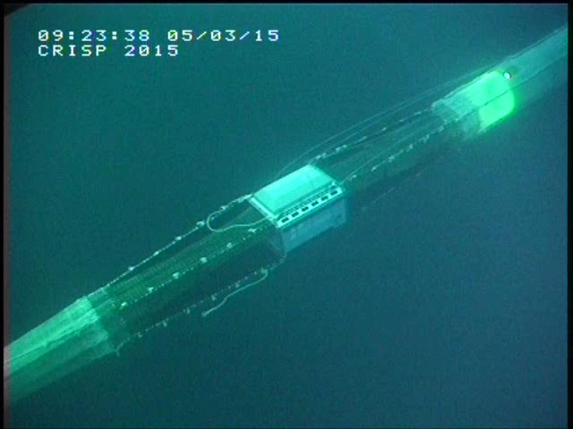
Deep Vision deployment
~ 60m
~ 40m
1-2m
Range for good images ≤ 3 m
Notes:
DeepVision unit is placed between extension and codend of trawl, where all catch can be guided within range of the cameras

Slide 8
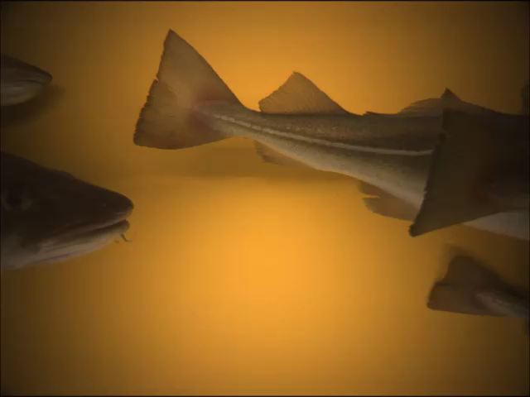
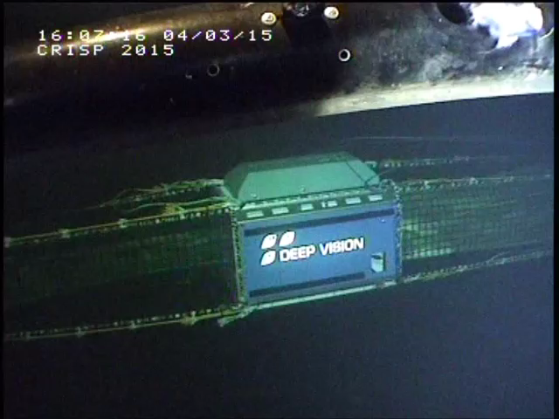
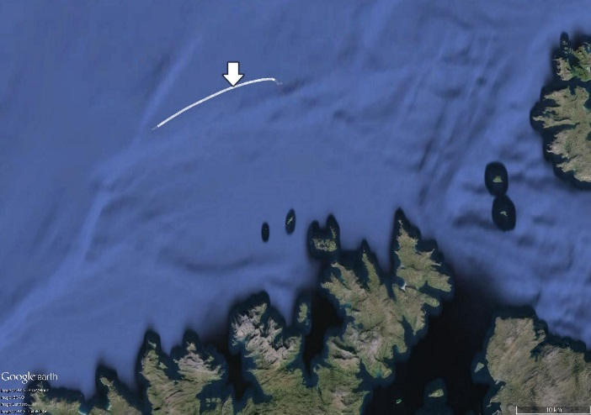
3 cod passing per second
(19 tonnes per hour)
Images
146 m depth

Slide 9
Deep Vision image analysis software

Slide 10

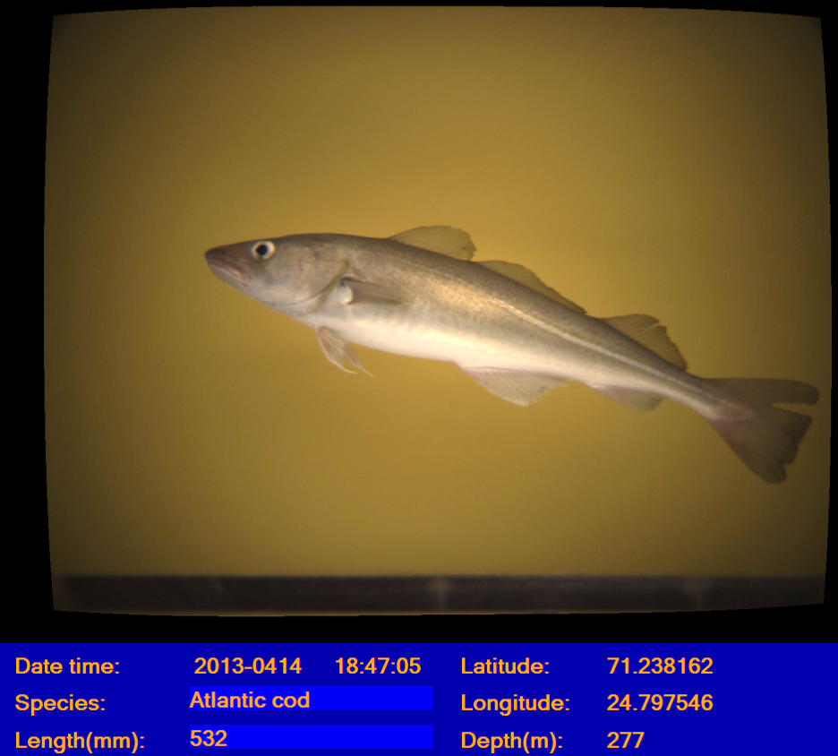

Slide 11
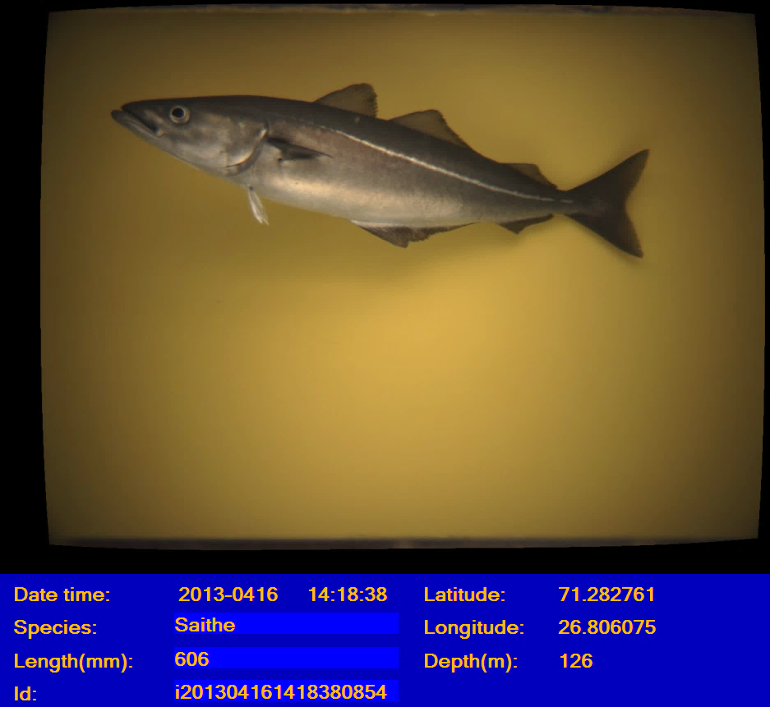

Slide 12
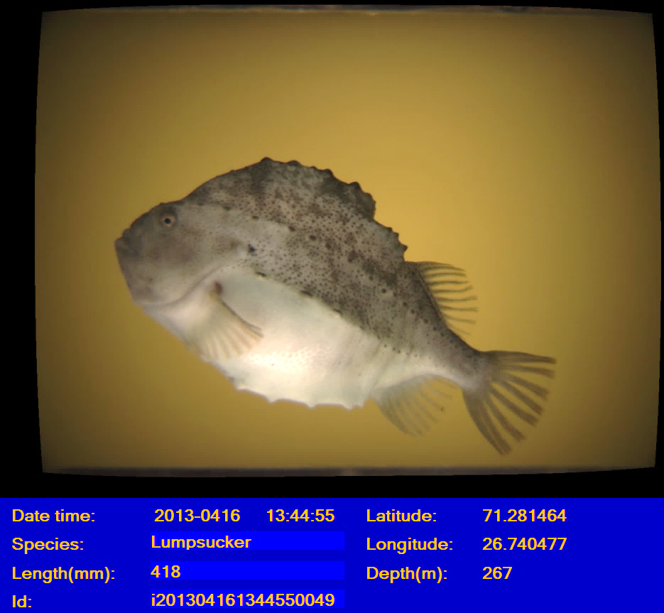

Slide 13
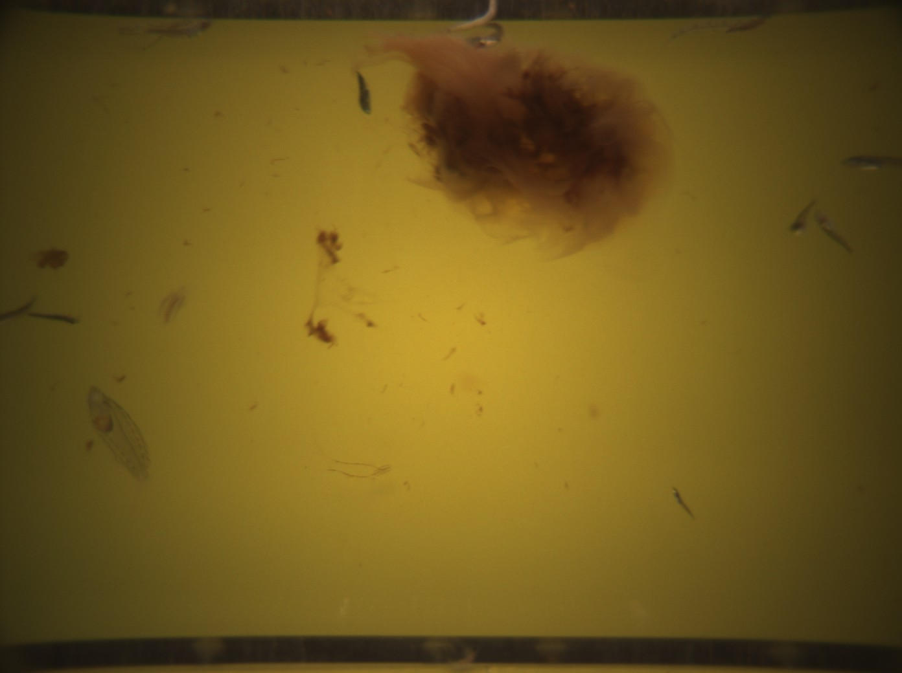
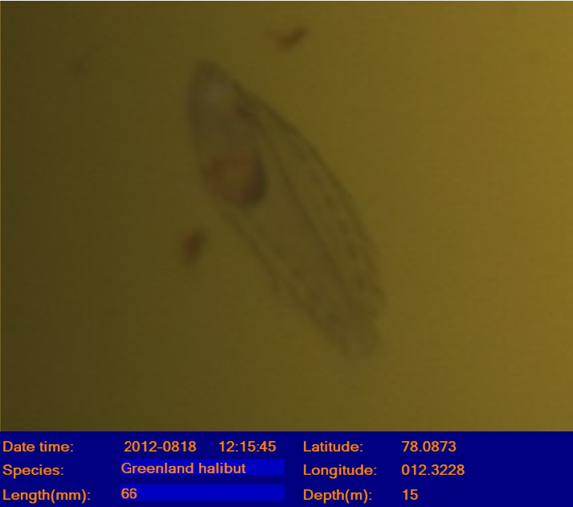
Juvenile fish
+
+

Slide 14
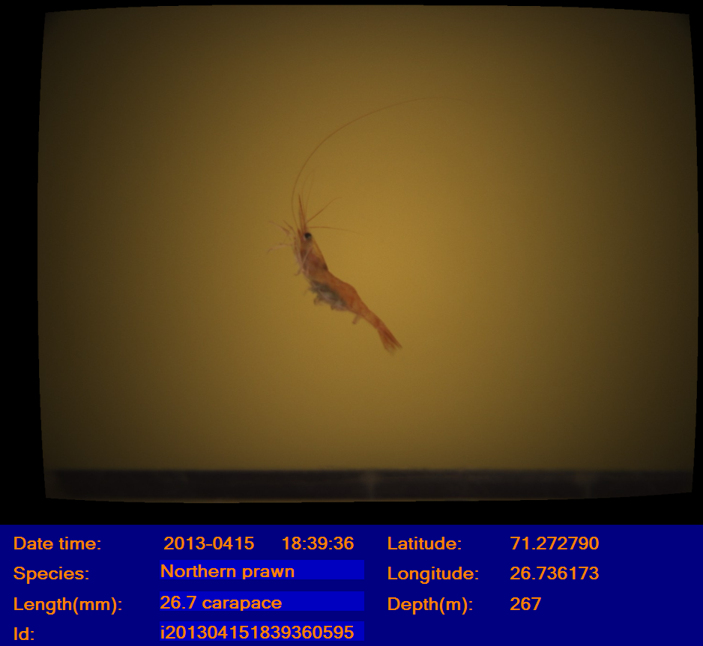
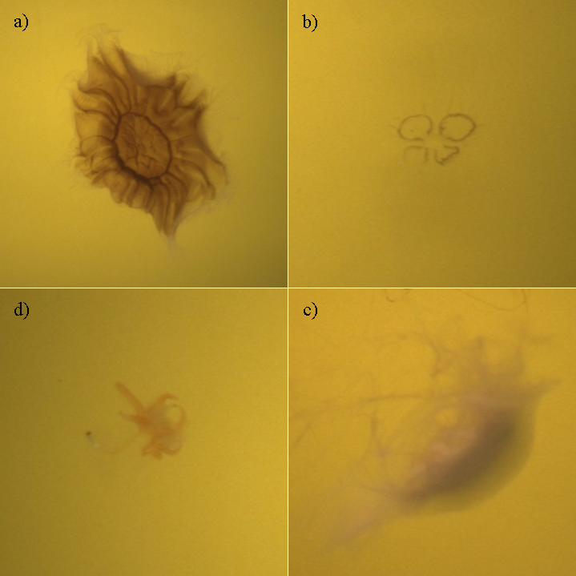
Crustaceans and large zooplankton
northern shrimp
jellyfish and siphonophor
(normally destroyed in trawl)

Slide 15
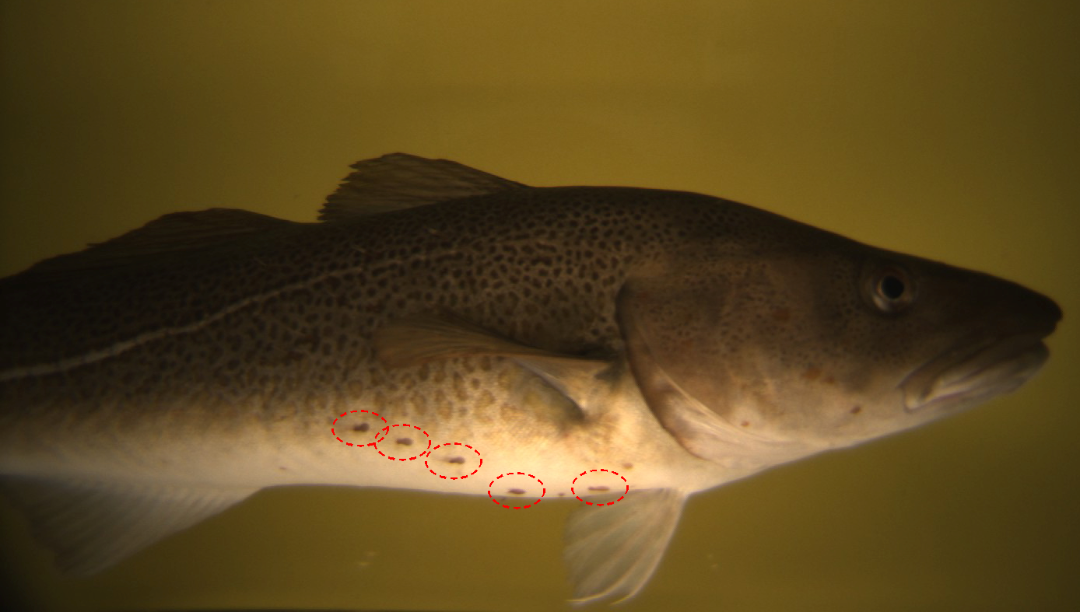
Parasites
Atlantic cod with sea lice (parasitic copepods)

Slide 16
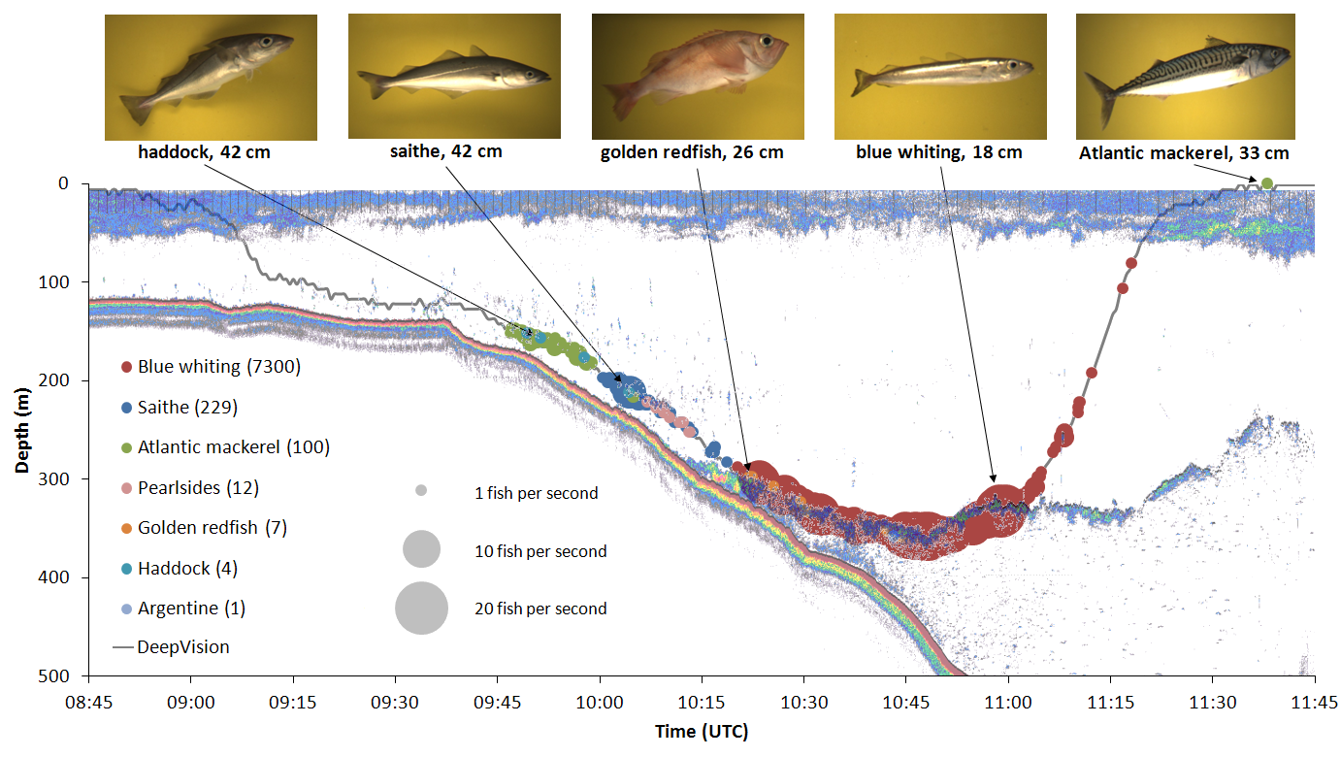
Precise spatial information
Rosen and Holst 2013
Time and depth of each passage
Species and size
Passage rate (density)
Species overlap

Slide 17

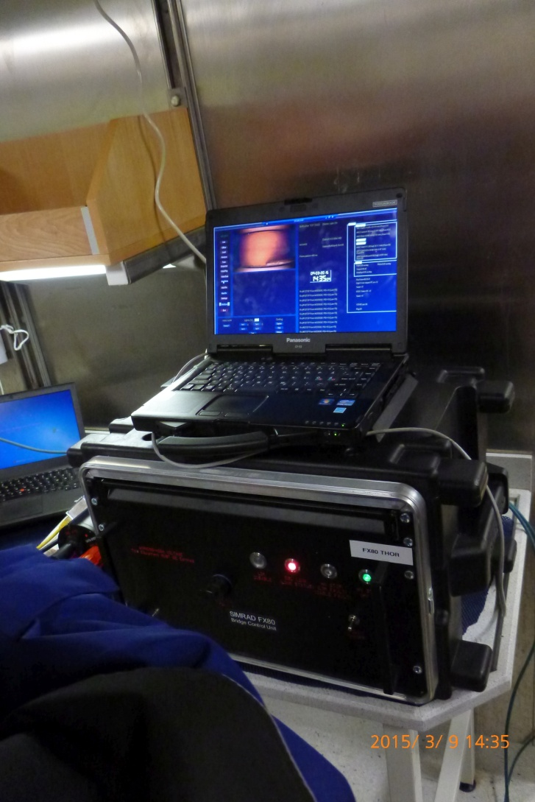
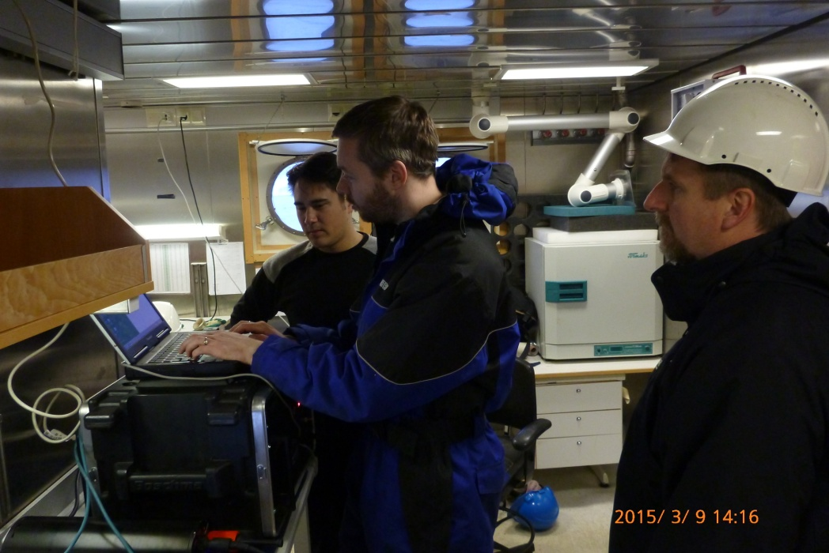






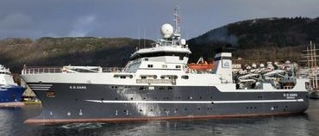
Live images and data to vessel
Ethernet trawl sonar and streaming video

Slide 18
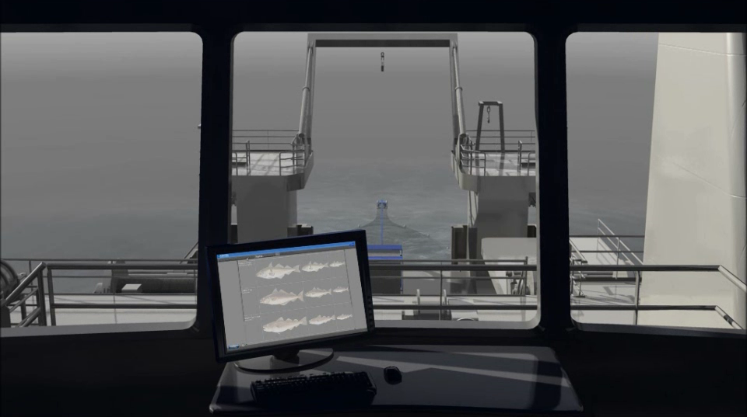
Future: tool for more targetted commercial fishing

Slide 19

Thank you for your attention
Notes:
Hovedside

Slide 21
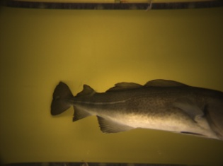
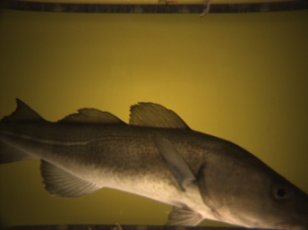
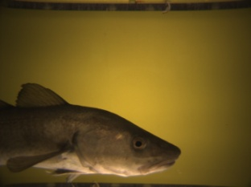
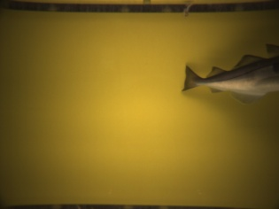
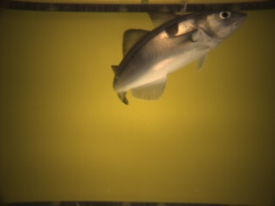
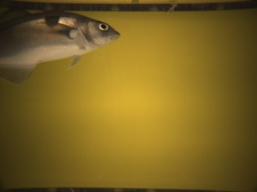
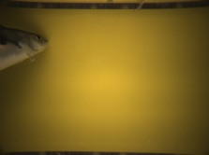
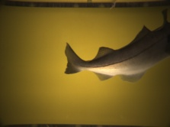
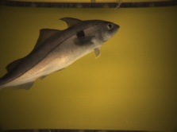
Poorly oriented fish
Too large to fit in a single image
Curved
No images with both snout and tail visible

Slide 22
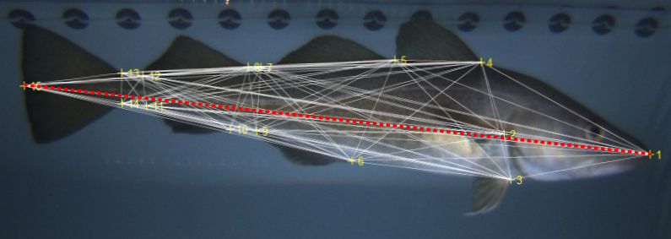
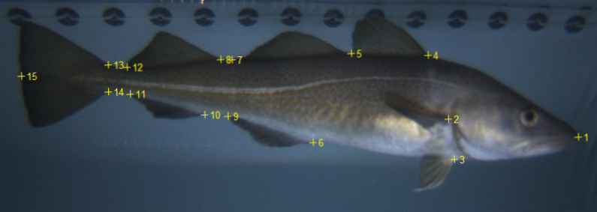
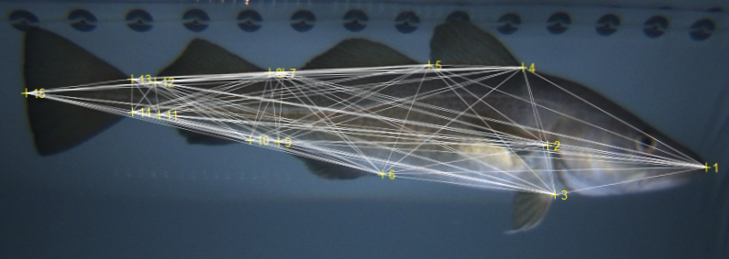
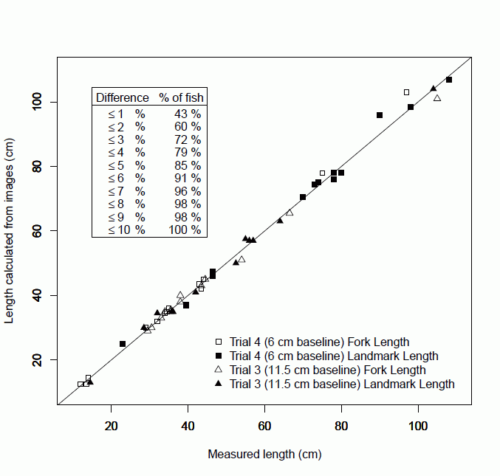
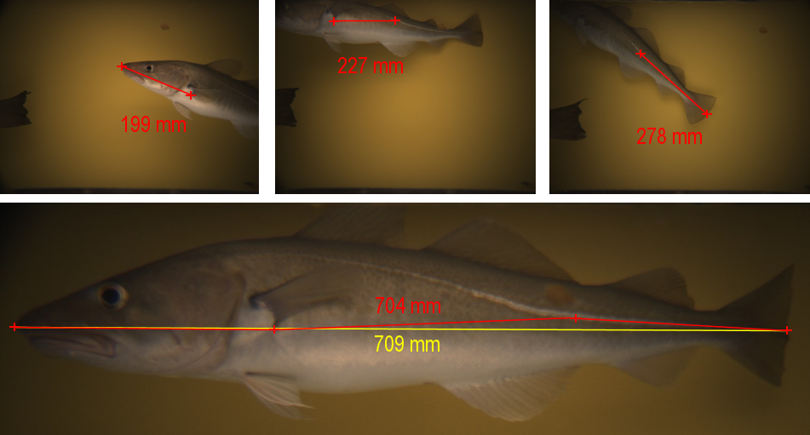
Measuring poorly oriented fish
Scale up landmark distances
15 landmark points
105 landmark distances
Calculate ratio between each landmark distance and total length
Measure landmark distance, scale up to total length
Sum shorter invervals
Notes:
An ”extra” slide shows verification of the landmark distance technique. For 81% of test fish, error was ≤ 2%, for all fish error was < 6%

Slide 23
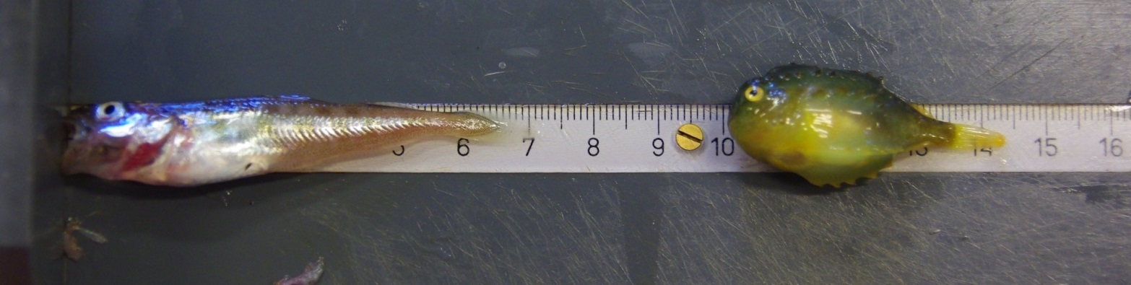
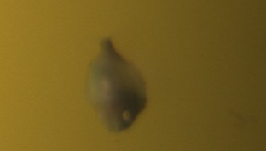
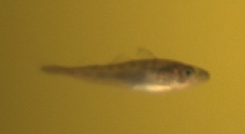
Verification of juvenile fish lengths
Atlantic cod
measured standard length: 65mm
standard length from image: 63mm
lumpsucker
measured standard length: 36mm
standard length from image: 36mm

Slide 24
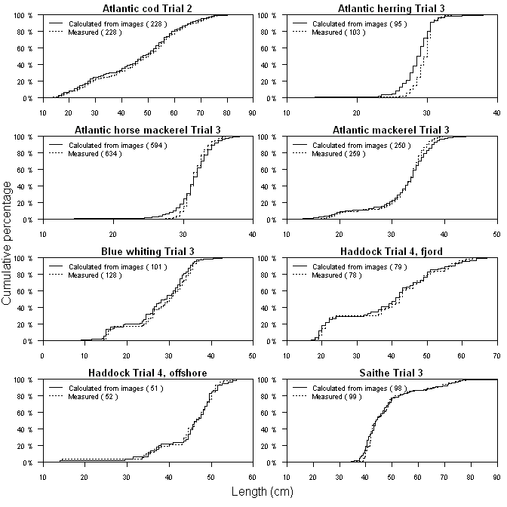
Length frequencies (large catches)
21 species, 4-625 individuals per species (1631 total)
Lengths calculated from images for 1631 of 1699 fish imaged and identified (96%)
Difference in length distribution only for Atlantic herring and Atlantic horse mackerel
(Kolmogorov-Smirnov test)
Rosen et al. 2013

Slide 25
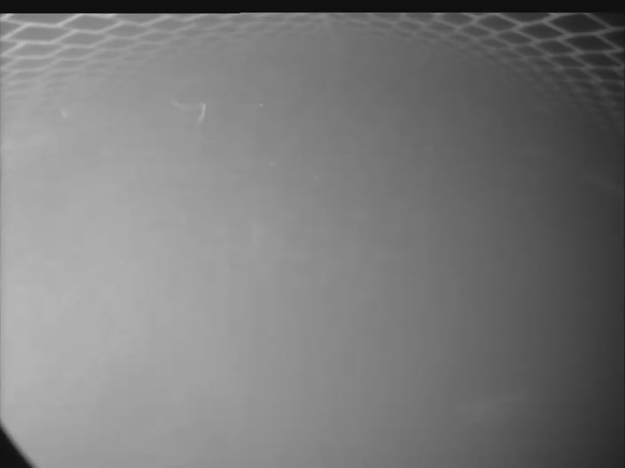
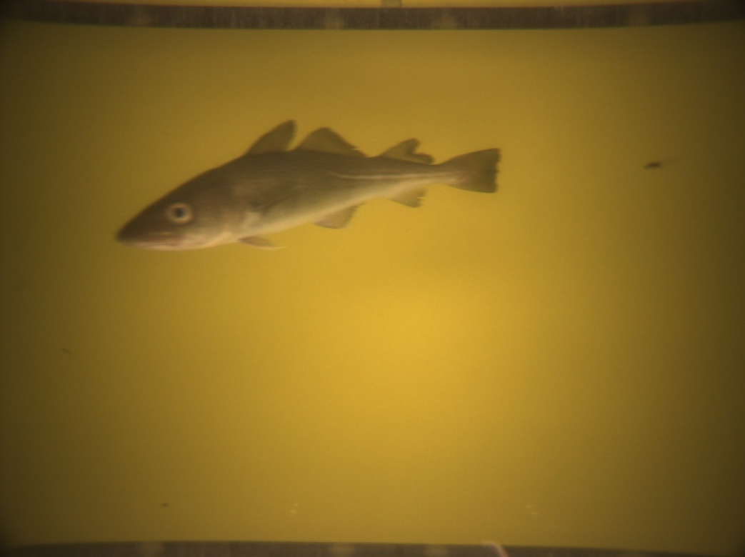
Challenges: turbid water
Monochrome observation camera (direct lighting)
DeepVision
(indirect lighting)
Atlantic cod approximately 3 m from camera
Same cod,10 seconds later
Diminished image quality, but useable for species and length id

Slide 26
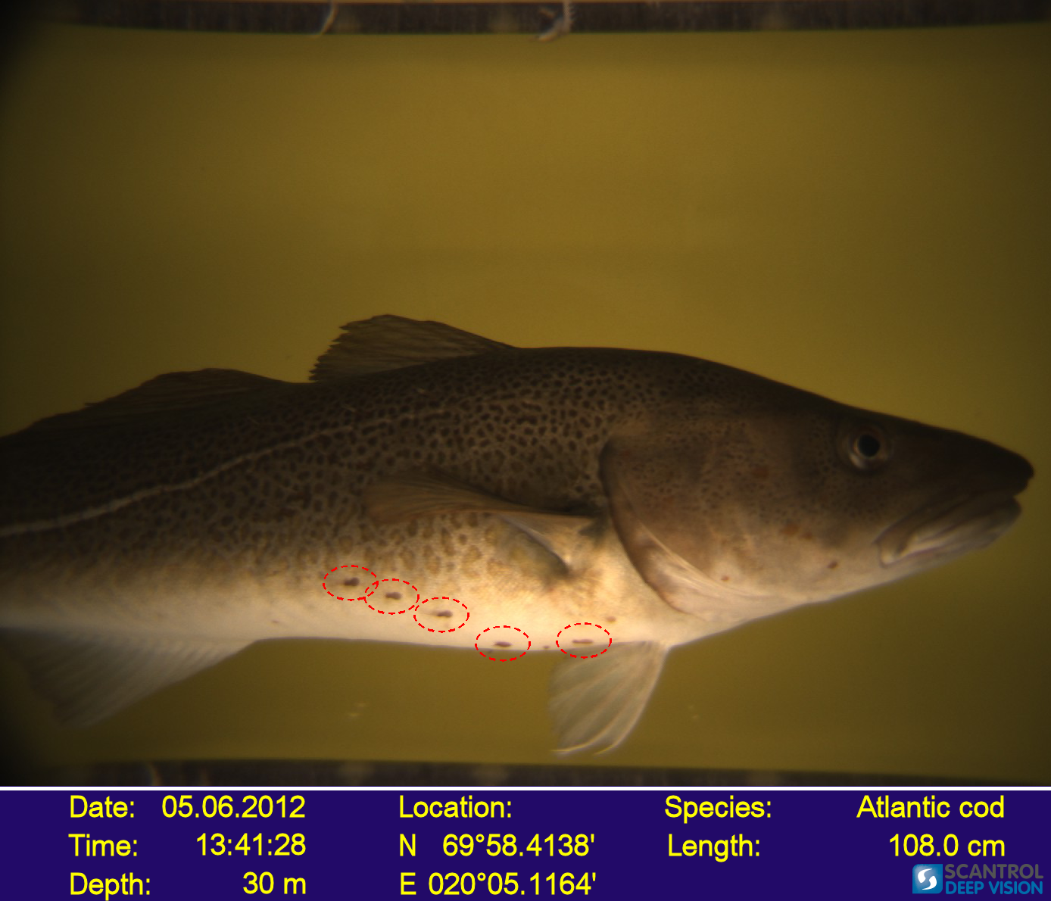

Slide 27
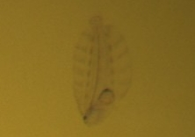
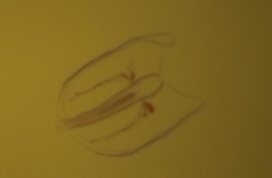

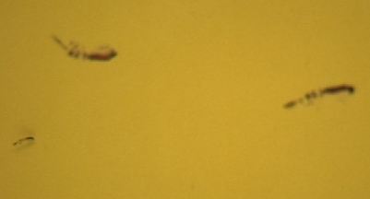
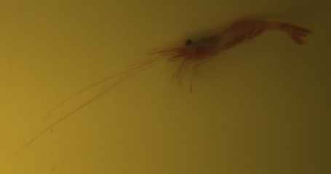
Ecosystem / juvenile fish survey
young of the year fish
5.0 cm Greenland halibut
6.5 cm Atlantic cod
3.6 cm lumpsucker
jellyfish, small crustaceans
comb jellyfish
krill
amphipods
shrimp
Underwood et al. submitted

Slide 28
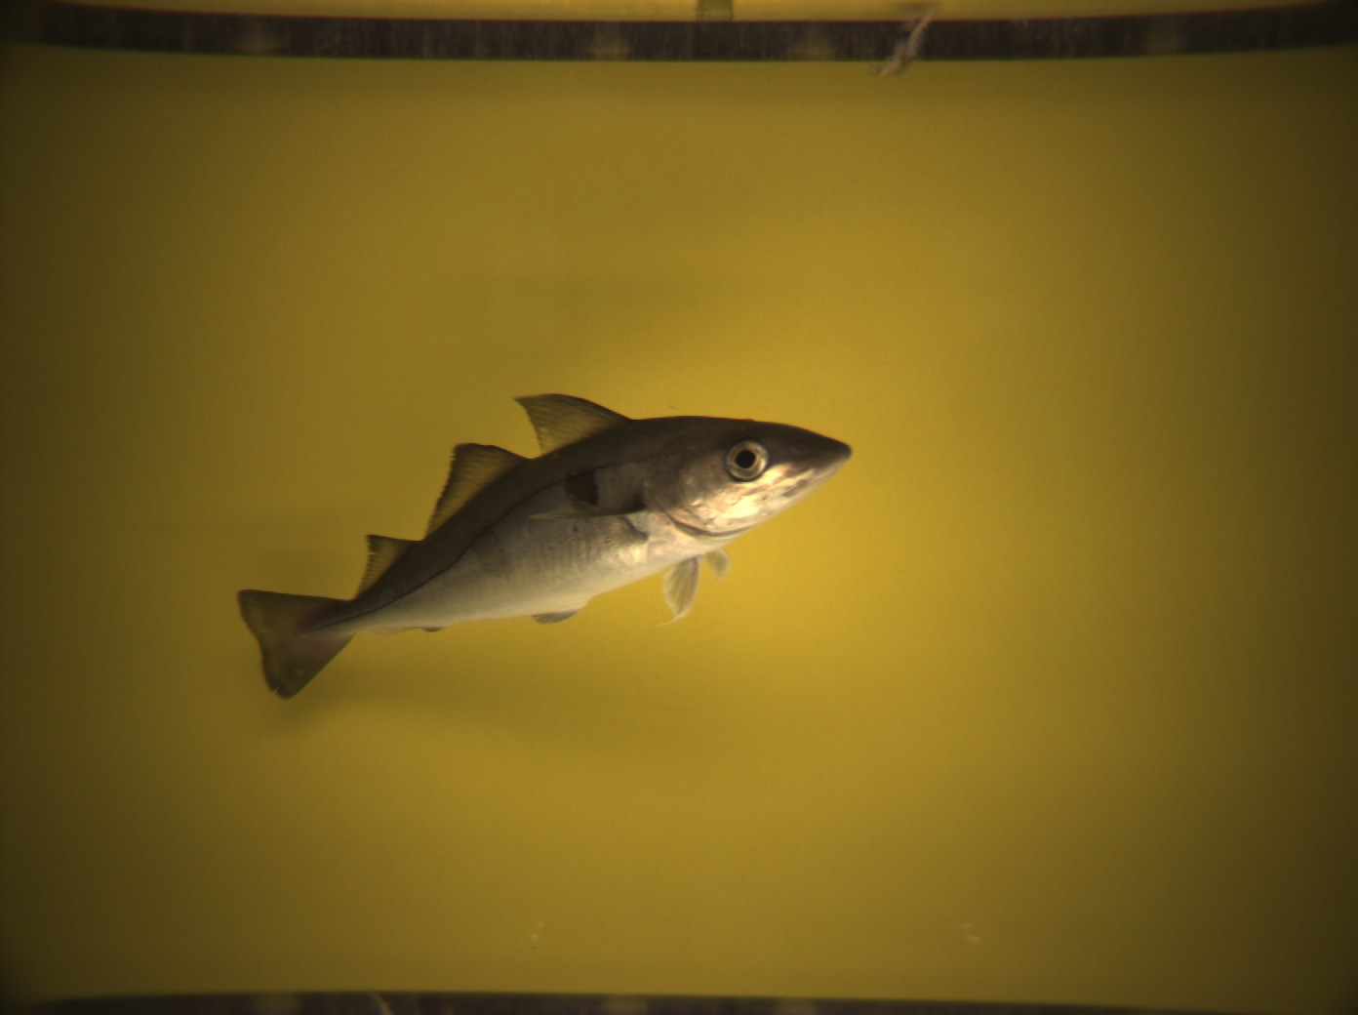
Length Measurement (theory)
+
( X₁, Y₁, Z₁ )
64 38 496
( X₂, Y₂, Z₂ )
+
-302 -82 657
Euclidean distance

Slide 29
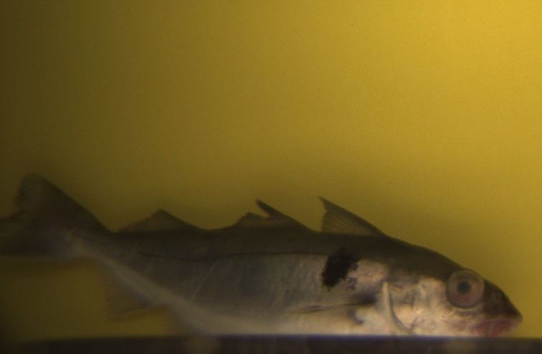
Data products: Information on specific fish of interest
decompression
compression
Haddock with decompression and fin / scale injuries, but alive
Recaptured discard / escapee from commercial fleet?

Slide 30
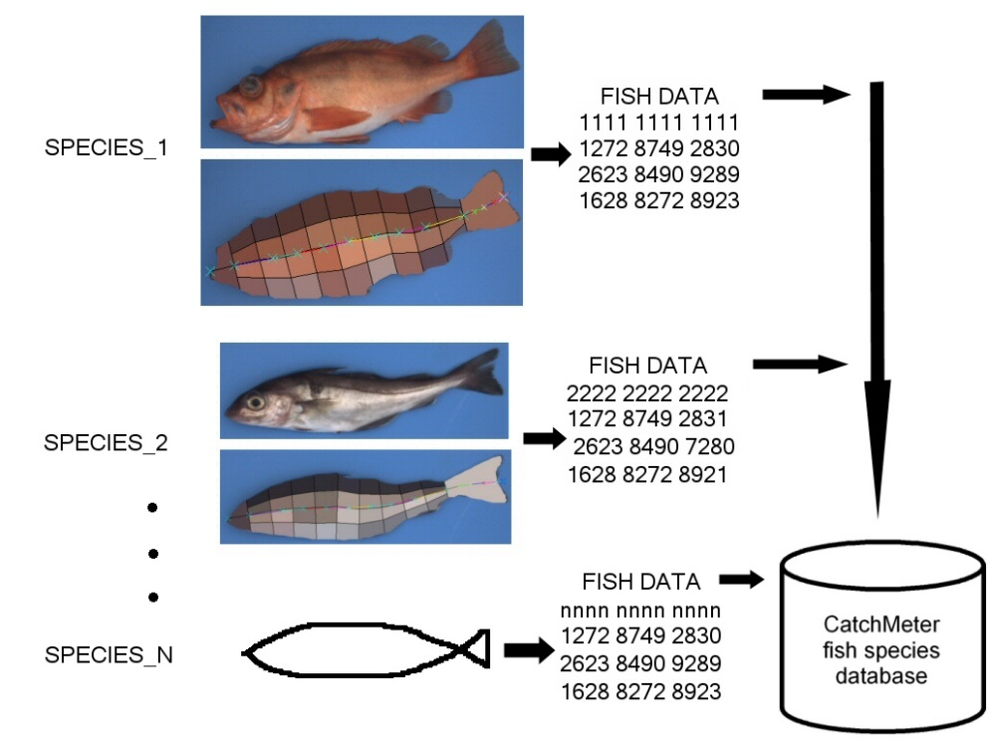

Automatic Species Identification
Training
Analysis
Fish species database
Analysis software
Fish species database

Slide 31


