Slide 1

Notes:
Hovedside

Slide 2

The capelin survey during the 2010 ecosystem investigations in the Barents Sea with a small taste from other parts of the investigations
Seminary on board G.O. Sars
6 October 2010
Harald Gjøsæter, IMR
Notes:
Tittelside

Slide 3
The capelin survey - background
Has long traditions, back to 1972
Russia and Norway, 4-6 vessels
Is, from 2003 part of the ecosystem survey
The effort is reduced since the start of the series
One of the few examples of an acoustic survey, where the results are used directly as an absolute estimate of stock size

Slide 4
The capelin survey - history
A dramatic history!
But a very interesting history!
Because capelin is one of the “pivot” or “key” species in the Barents Sea ecosystem, its dynamics signals fundamental events in the Barents Sea

Slide 5
The capelin survey - results 2010
“Impressions”
Distribution
Stock size
Stock structure

Slide 6
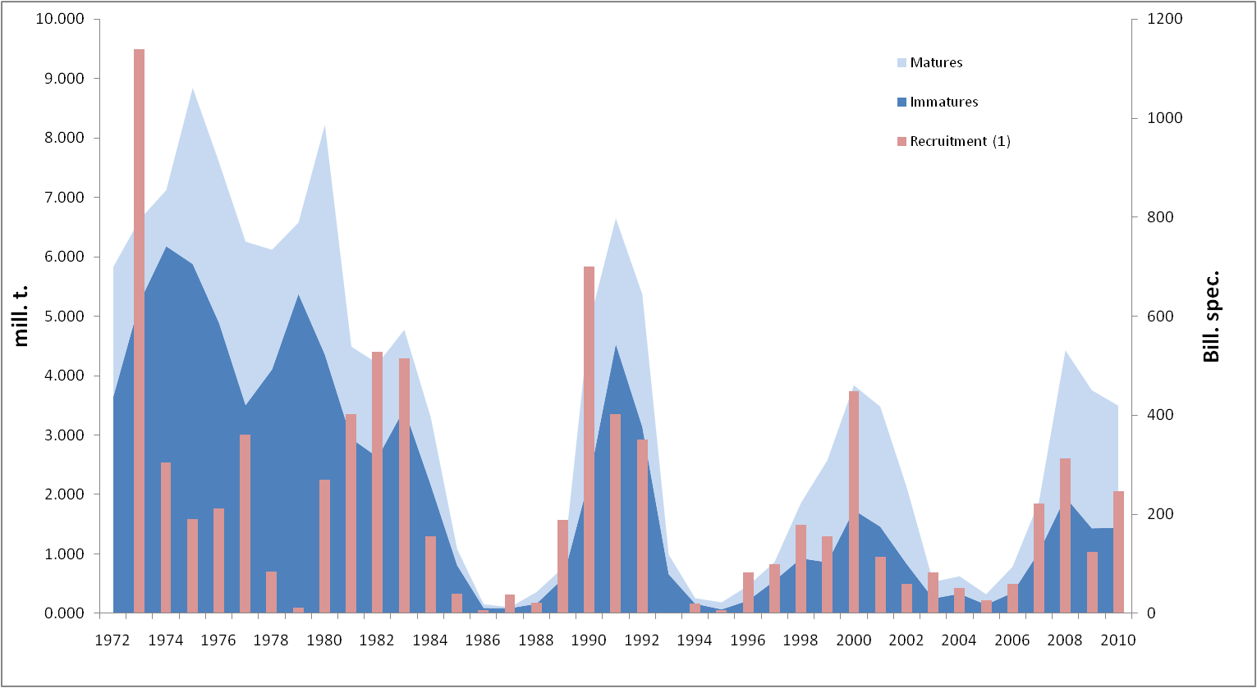
A dramatic but interesting story

Slide 7
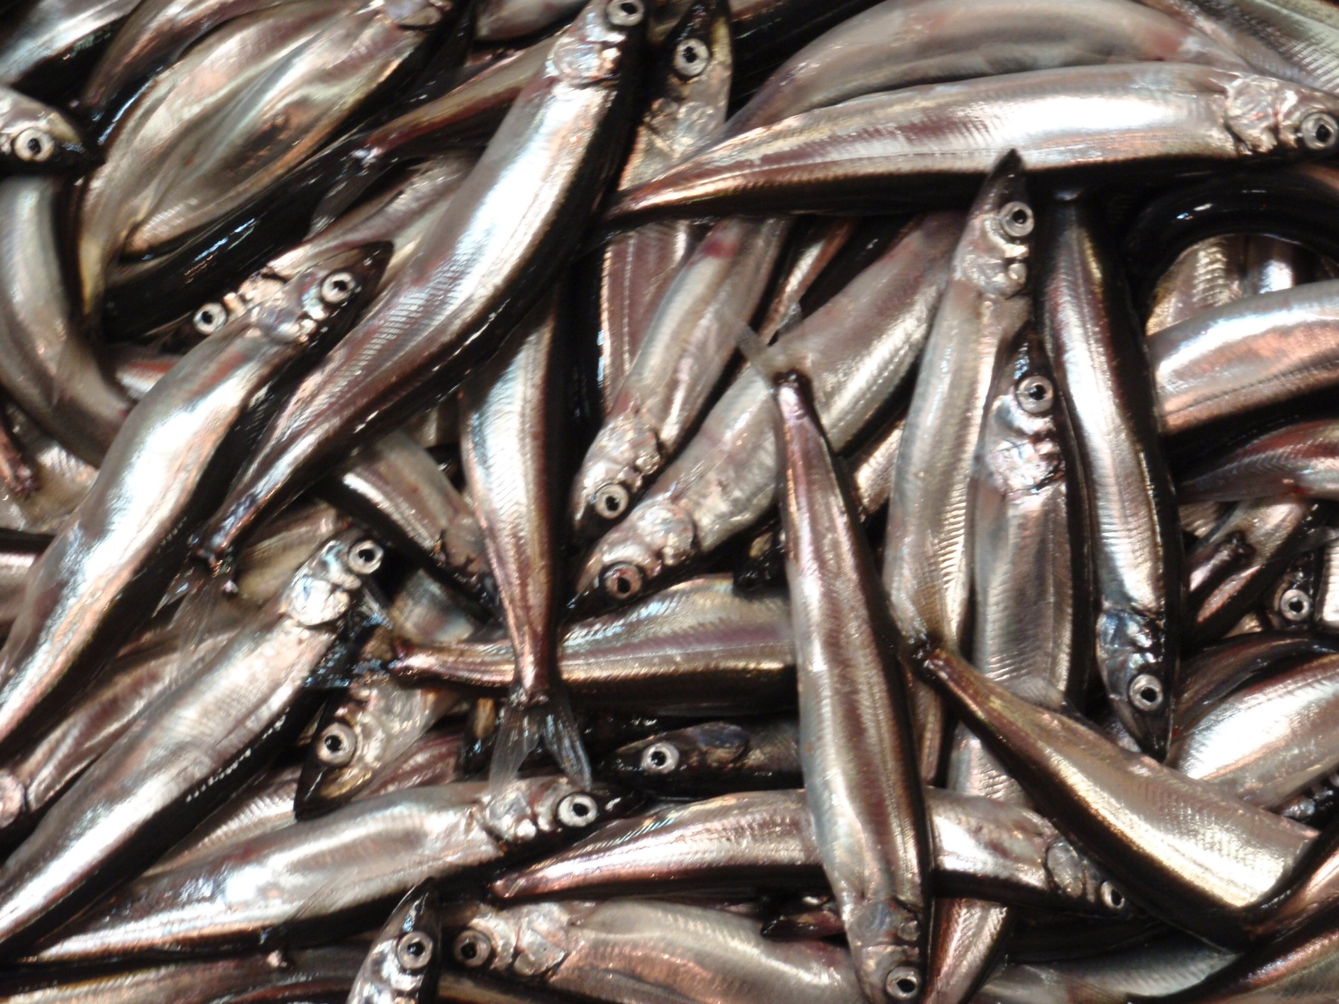
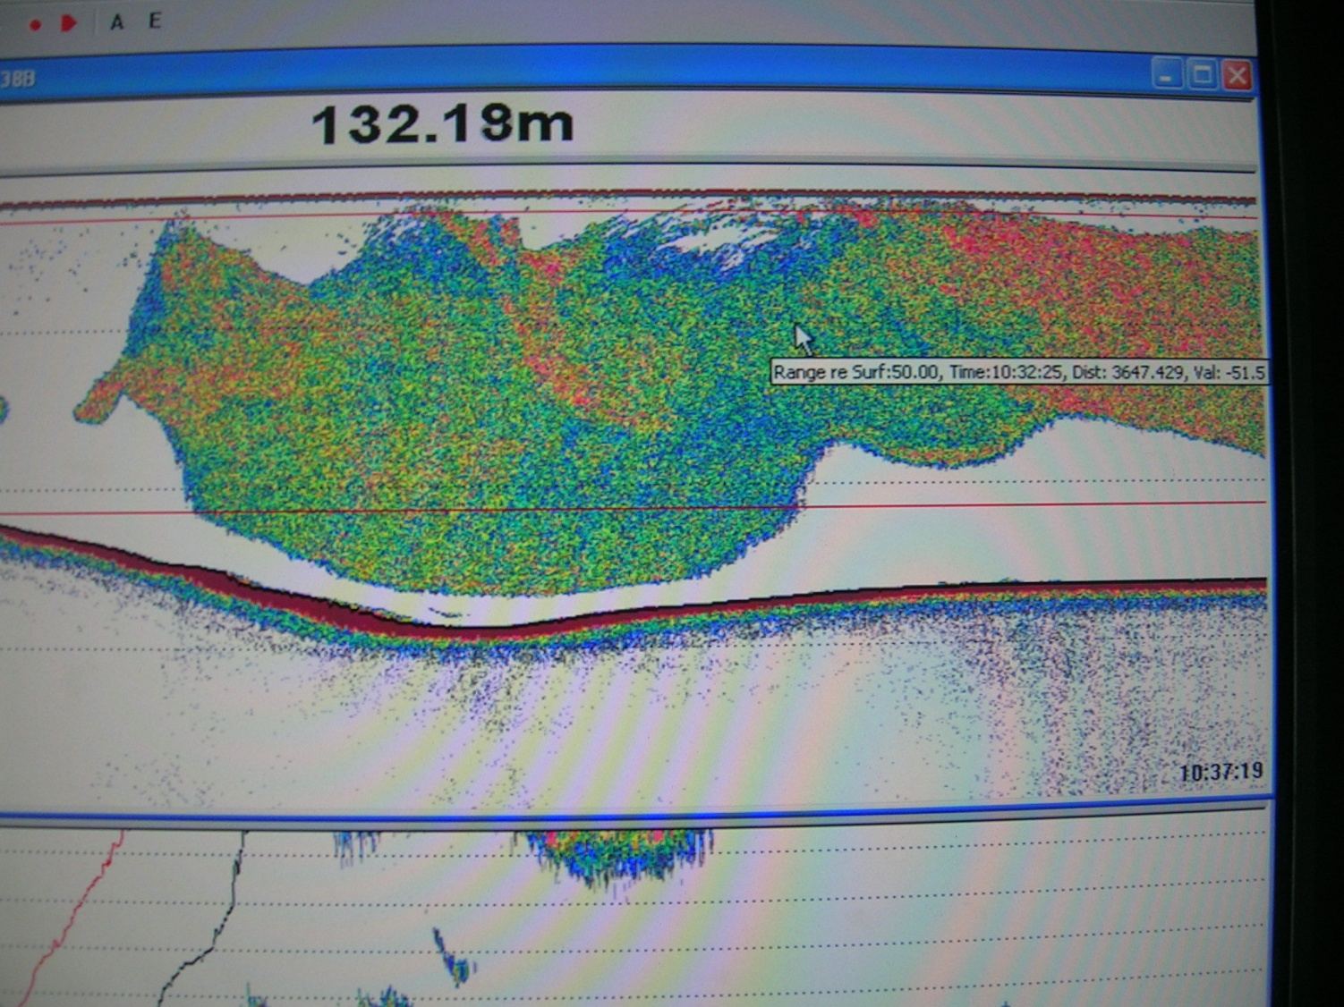
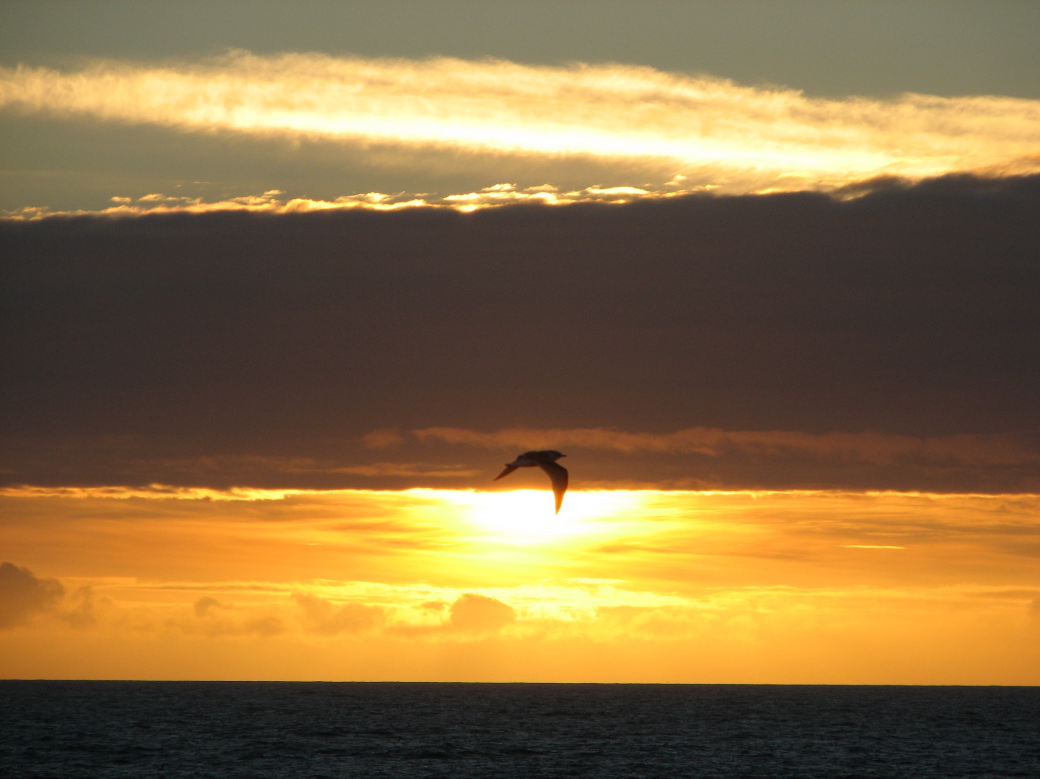
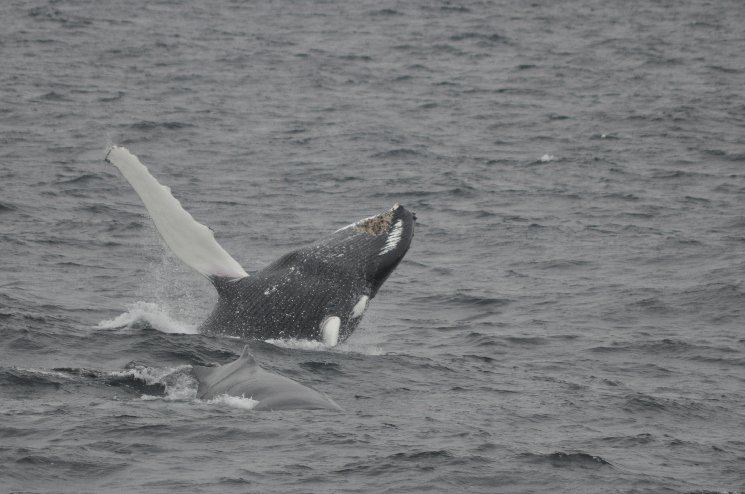
”Impressions”
The further north – the more interesting
The areas between Svalbard and Franz Josef Land are fascinating to visit and survey
There are
  whales,
  nice fish,
  big things on the echosounder,
  and every night there is a beautiful sunset!

Slide 8
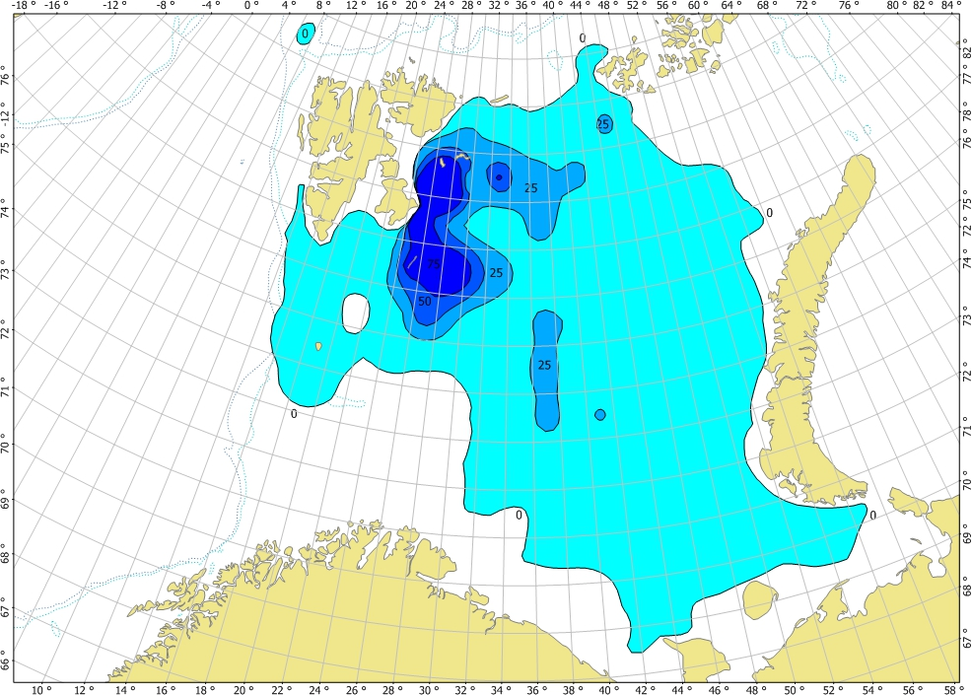
Capelin distribution
Very large area!
Northern limit and main
concentrations far north

Slide 9
Stock size and structure

Slide 10
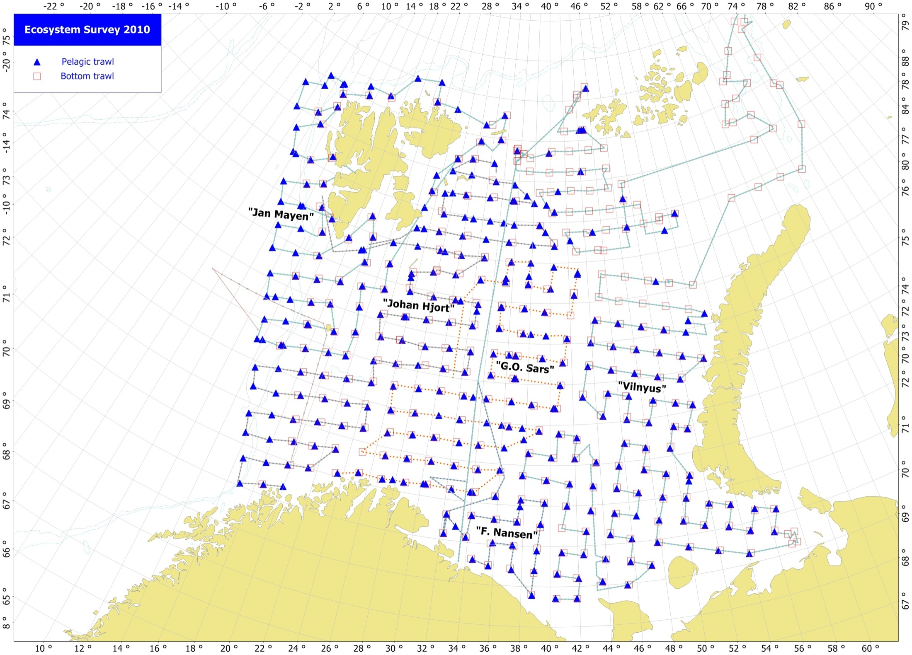
The rest of the survey
Total coverage,
Including northern Kara Sea

Slide 11
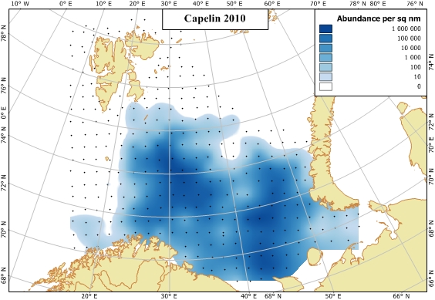
Recruitment
Capelin 0-group – a litle bit above average

Slide 12
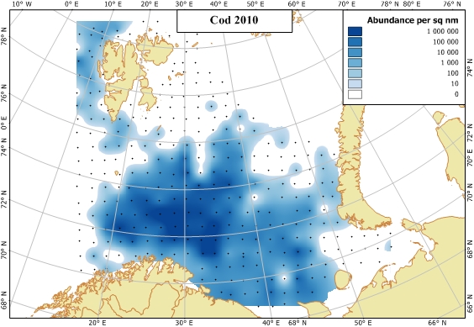
Recruitment
Cod 0-group – strong

Slide 13
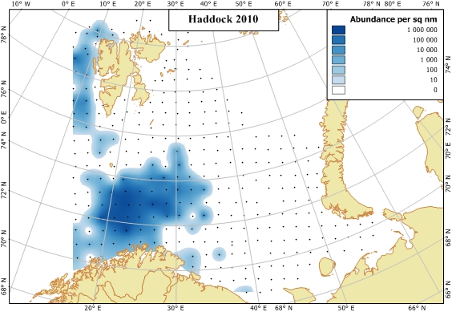
Recruitment
Haddock 0-group – strong

Slide 14
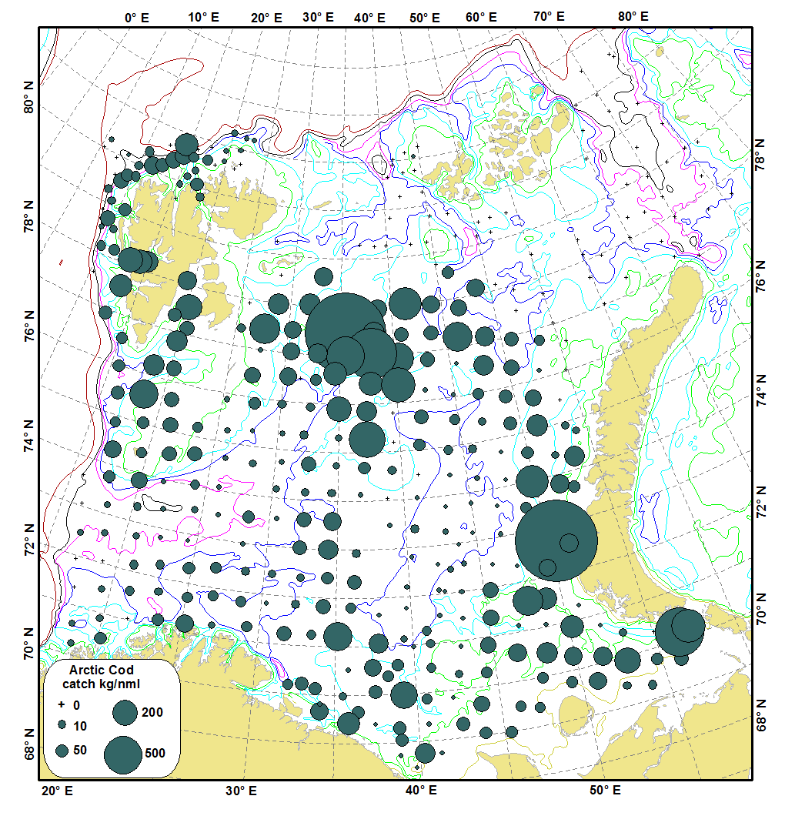
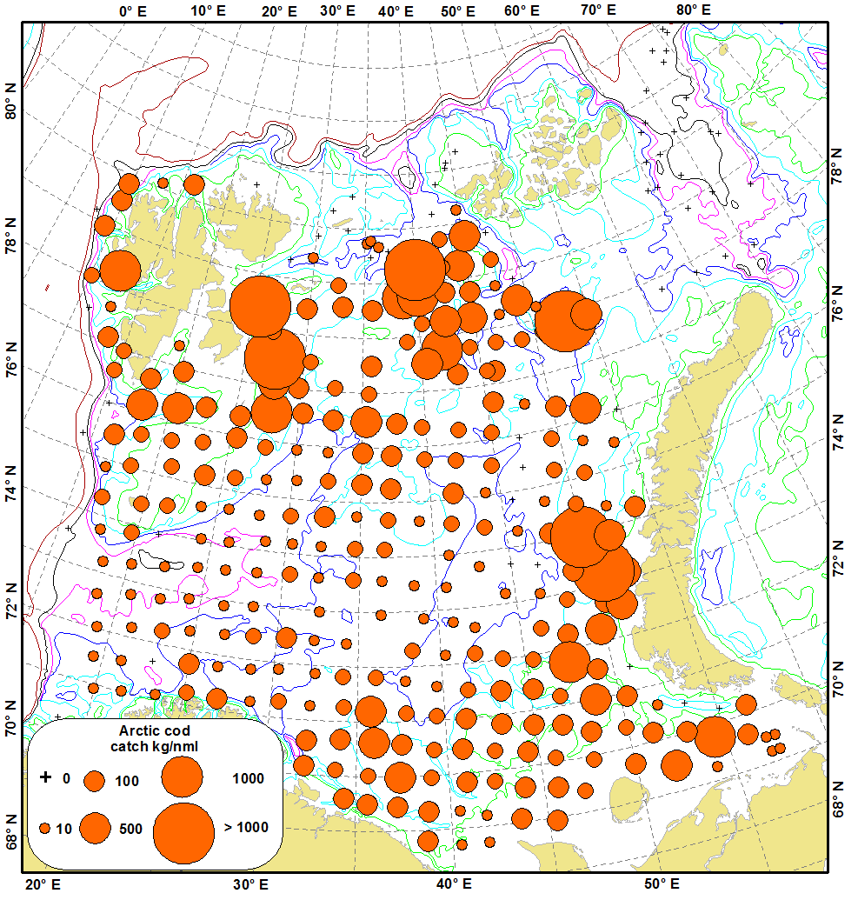
Other interesting things
2009
2010
Cod distribution in 2009 and 2010

Slide 15
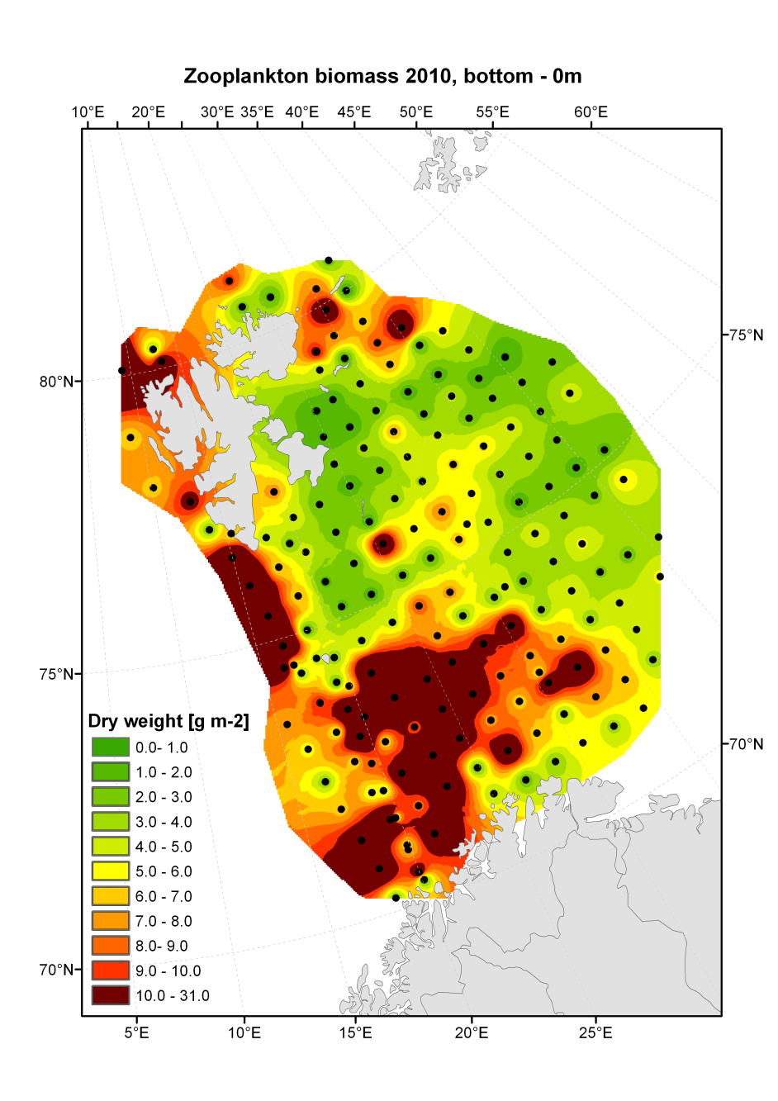
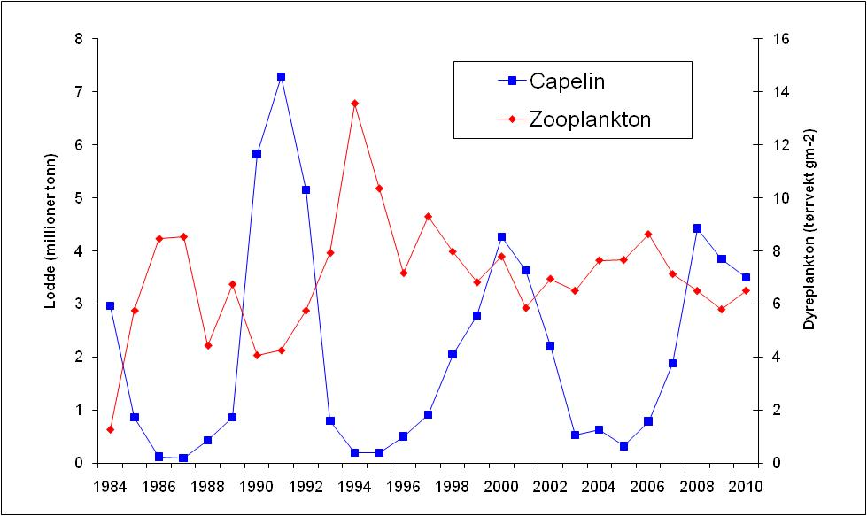
Plankton production
Zooplankton biomass at a stable and relatively high level

Slide 16
Conclusions
Its too early to draw any final conclusions from this survey, but the impression so far is that:
The Barents Sea is in a healthy state, with high plankton production, large fish stocks, and good recruitment to these fish stocks

Slide 17


Спасибо за Ваше
внимание
Takk for merksemda

